Slide 1
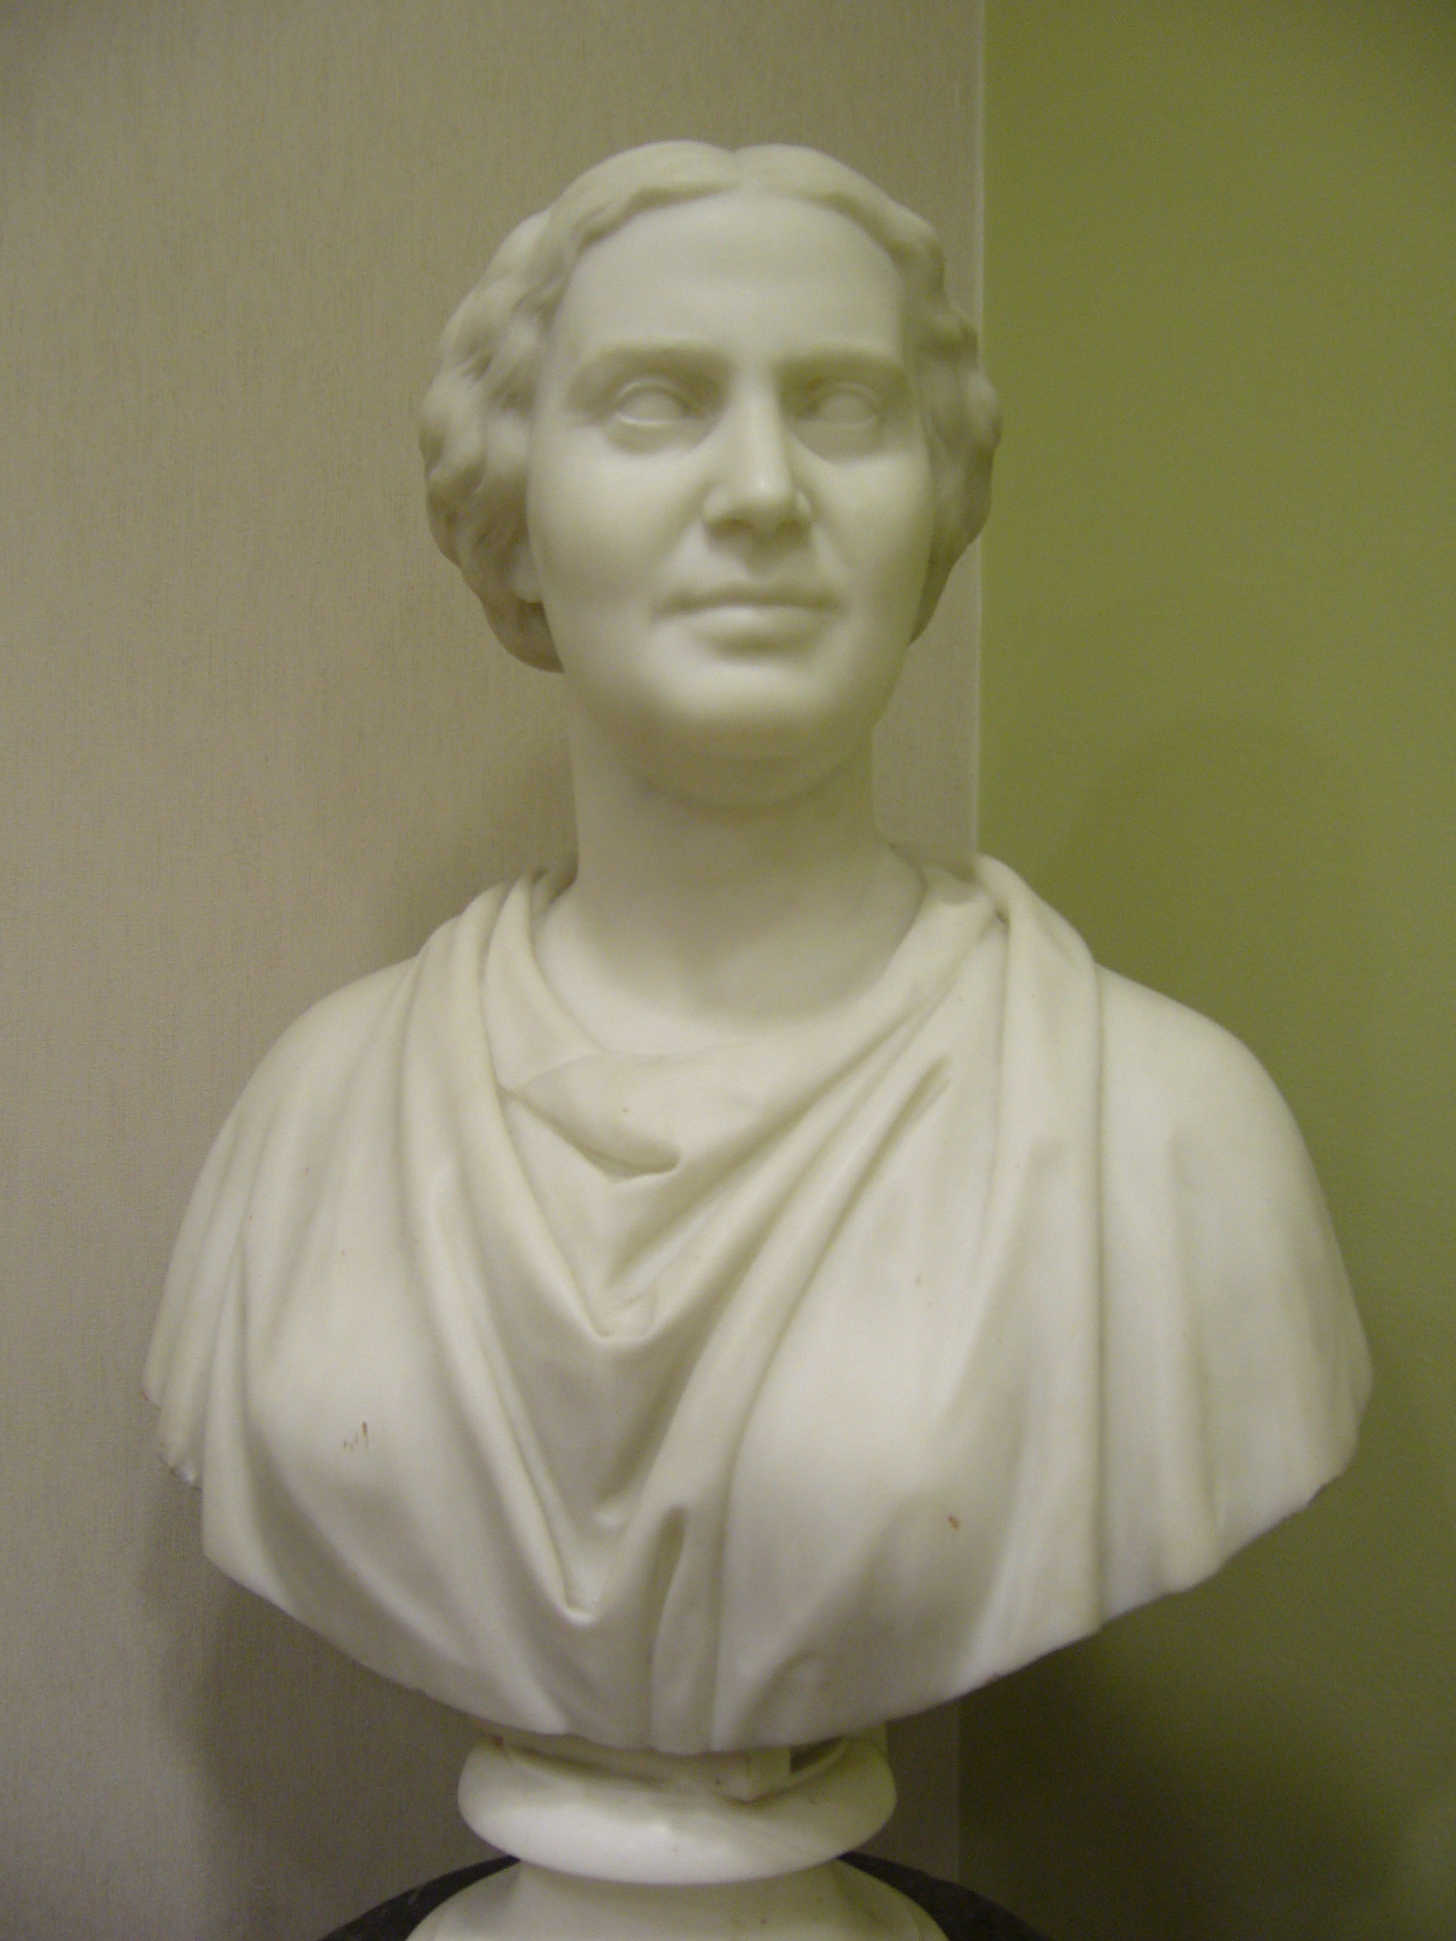
Spot Value
NOSE
3
RIGHT EAR
2
LEFT EAR
4
RIGHT SHOULDER
1
LEFT SHOULDER
5
Notes:
Here it is. 1. Stand Up and find a partner 2. Here are the spot values: right shoulder = 1, right ear = 2, nose = 3, left ear = 4 and left shoulder is 5. 3. Without talking, one person will touch two of their own number spots and the other person will have to say the numbers out L
loud and then add them together. 4. Once one person has done a few problems, the other person can give some problems. This brain break is great becasue it forces you to READ your partner's number spots. You have to think of the spots in THEIR perspective. I have students who often turn their back so as to "think" of their partners vantage point.

