Slide 1
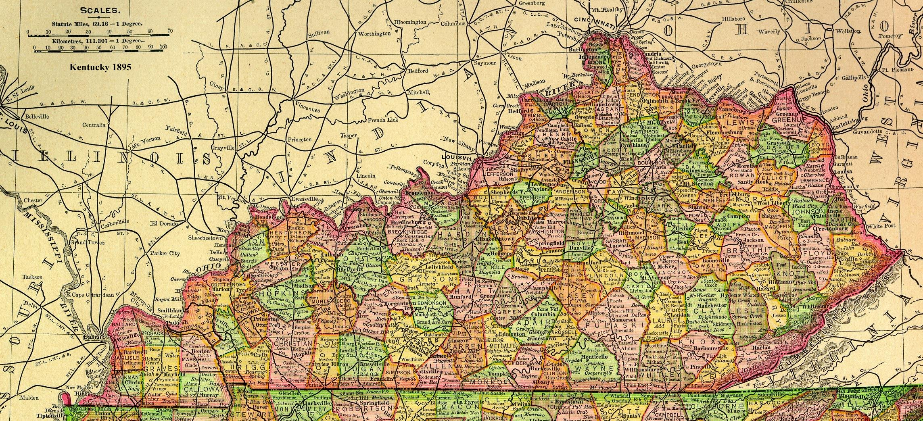
The Kentucky Game GiftedGuru.com

Slide 2
I love this simple, low-prep game for getting kids to practice their math facts without weeping & wailing. It’s also wonderful for developing spatial awareness and learning to see things from someone else’s perspective. I was in Kentucky for the KAGE conference in beautiful Lexington, and I shared this game with a group of teachers. They asked what it was called, and I had no idea! We decided to call it “The Kentucky Game.” If you know it by another, feel free to let me know! Here’s how to play: 1. Students get a partner. Using the displayed image as a guide, the first student touches two places of the five options (for instance, left shoulder and nose). 2. The partner then adds up the values of those two places and says the sum. For instance, if the left shoulder is five and the nose is three, the sum would be eight. 3. Then, they switch and the other student chooses two places and the partner adds up the sum. 4. Play continues until whatever limit the teacher sets (each person has three turns, etc.). Options: To make it more challenging, use operations harder than addition (multiplication, etc.) or more difficult numbers (fractions, etc.). I’ve made it editable, so you can put in whatever numbers you like. If you have questions, please email me at lisa@giftedguru.com. Have a great time playing The Kentucky Game! Lisa

Slide 3
Spot Value
3
2
4
1
5

