Slide 2
An Intense Introduction

Slide 3
Positive Disintegration: It sounds bad, but it’s really not.

Slide 4
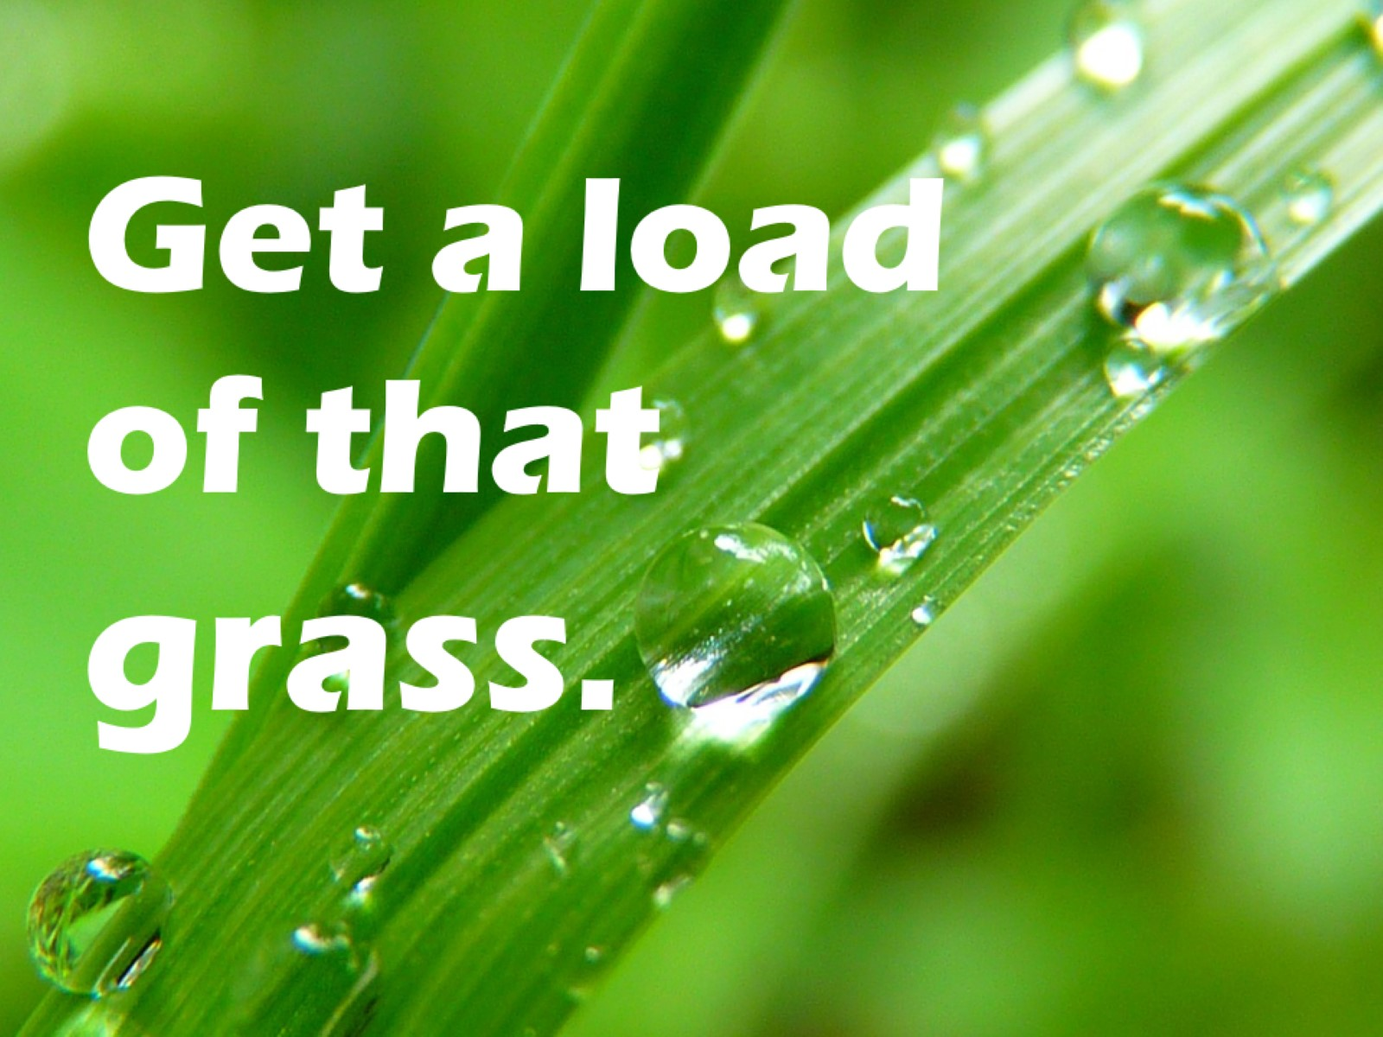
Get a load of that grass.

Slide 5
OVEREXCITABILITIES, a.k.a. INTENSITIES

Slide 6
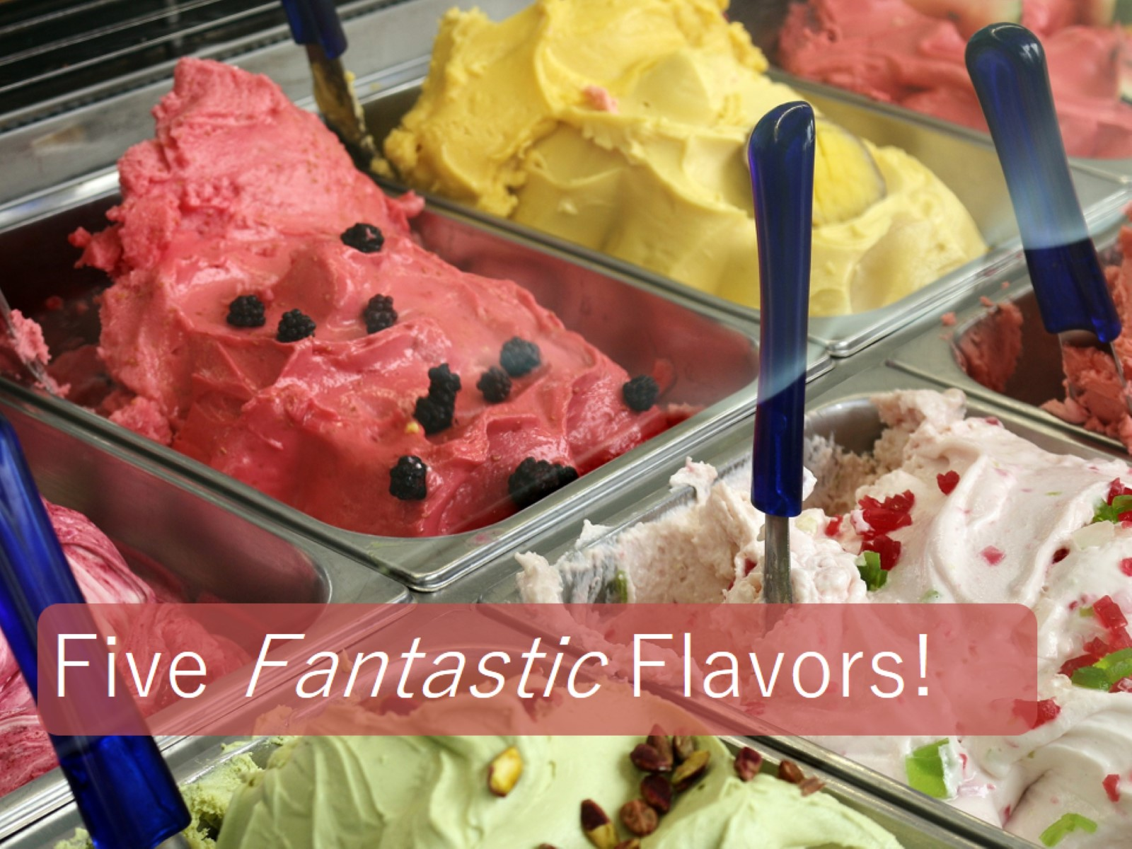

Slide 7
Intellectual Intensity

Slide 8
curiosity concentration focus strong memory independent thinkers blurt out visual memory hypercritical

Slide 9
curiosity concentration focus strong memory independent thinkers blurt out visual memory hypercritical

Slide 10
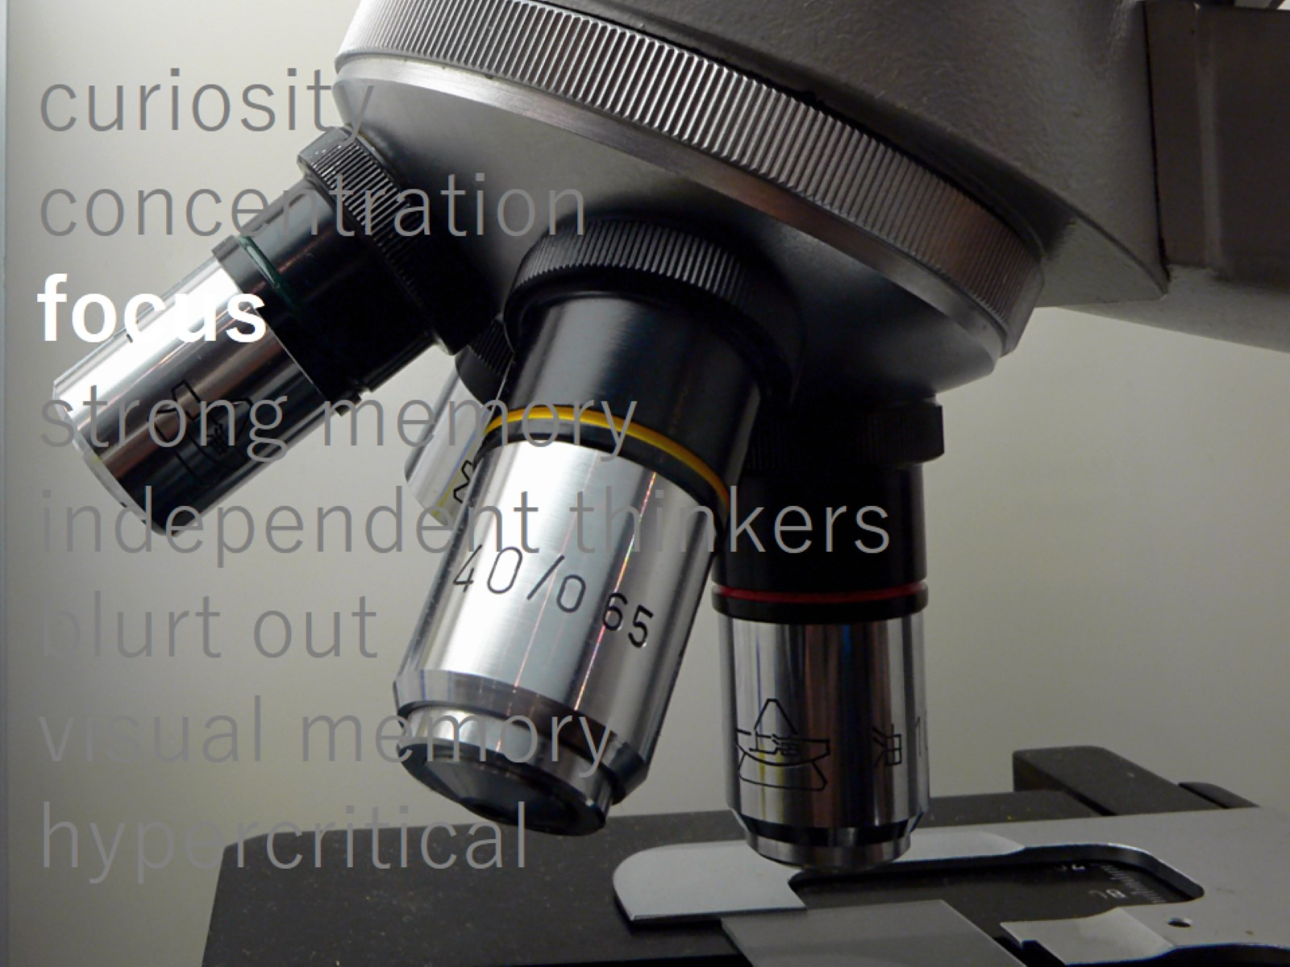
curiosity concentration focus strong memory independent thinkers blurt out visual memory hypercritical

Slide 11
curiosity concentration focus strong memory independent thinkers blurt out visual memory hypercritical

Slide 12
curiosity concentration focus strong memory independent thinkers blurt out visual memory hypercritical

Slide 13
curiosity concentration focus strong memory independent thinkers blurting out visual memory hypercritical

Slide 14
curiosity concentration focus strong memory independent thinkers blurt out visual memory hypercritical

Slide 15
curiosity concentration focus strong memory independent thinkers blurt out visual memory hypercritical

Slide 16
Psychomotor Intensity

Slide 17
surplus energy rapid speech need for action nervous habits workaholicism compulsive ____ competitiveness they love it, but …

Slide 18
surplus energy rapid speech need for action nervous habits workaholicism compulsive ____ competitiveness they love it, but …

Slide 19
surplus energy rapid speech need for action nervous habits workaholicism compulsive ____ competitiveness they love it, but …

Slide 20
surplus energy rapid speech need for action nervous habits workaholicism compulsive ____ competitiveness they love it, but …

Slide 21
surplus energy rapid speech need for action nervous habits workaholicism compulsive ____ competitiveness they love it, but …

Slide 22
surplus energy rapid speech need for action nervous habits workaholicism compulsive ____ competitiveness they love it, but …

Slide 23
surplus energy rapid speech need for action nervous habits workaholicism compulsive ____ competitiveness they love it, but …

Slide 24
surplus energy rapid speech need for action nervous habits workaholicism compulsive ____ competitiveness they love it, but …

Slide 25
Sensual Intensity

Slide 26
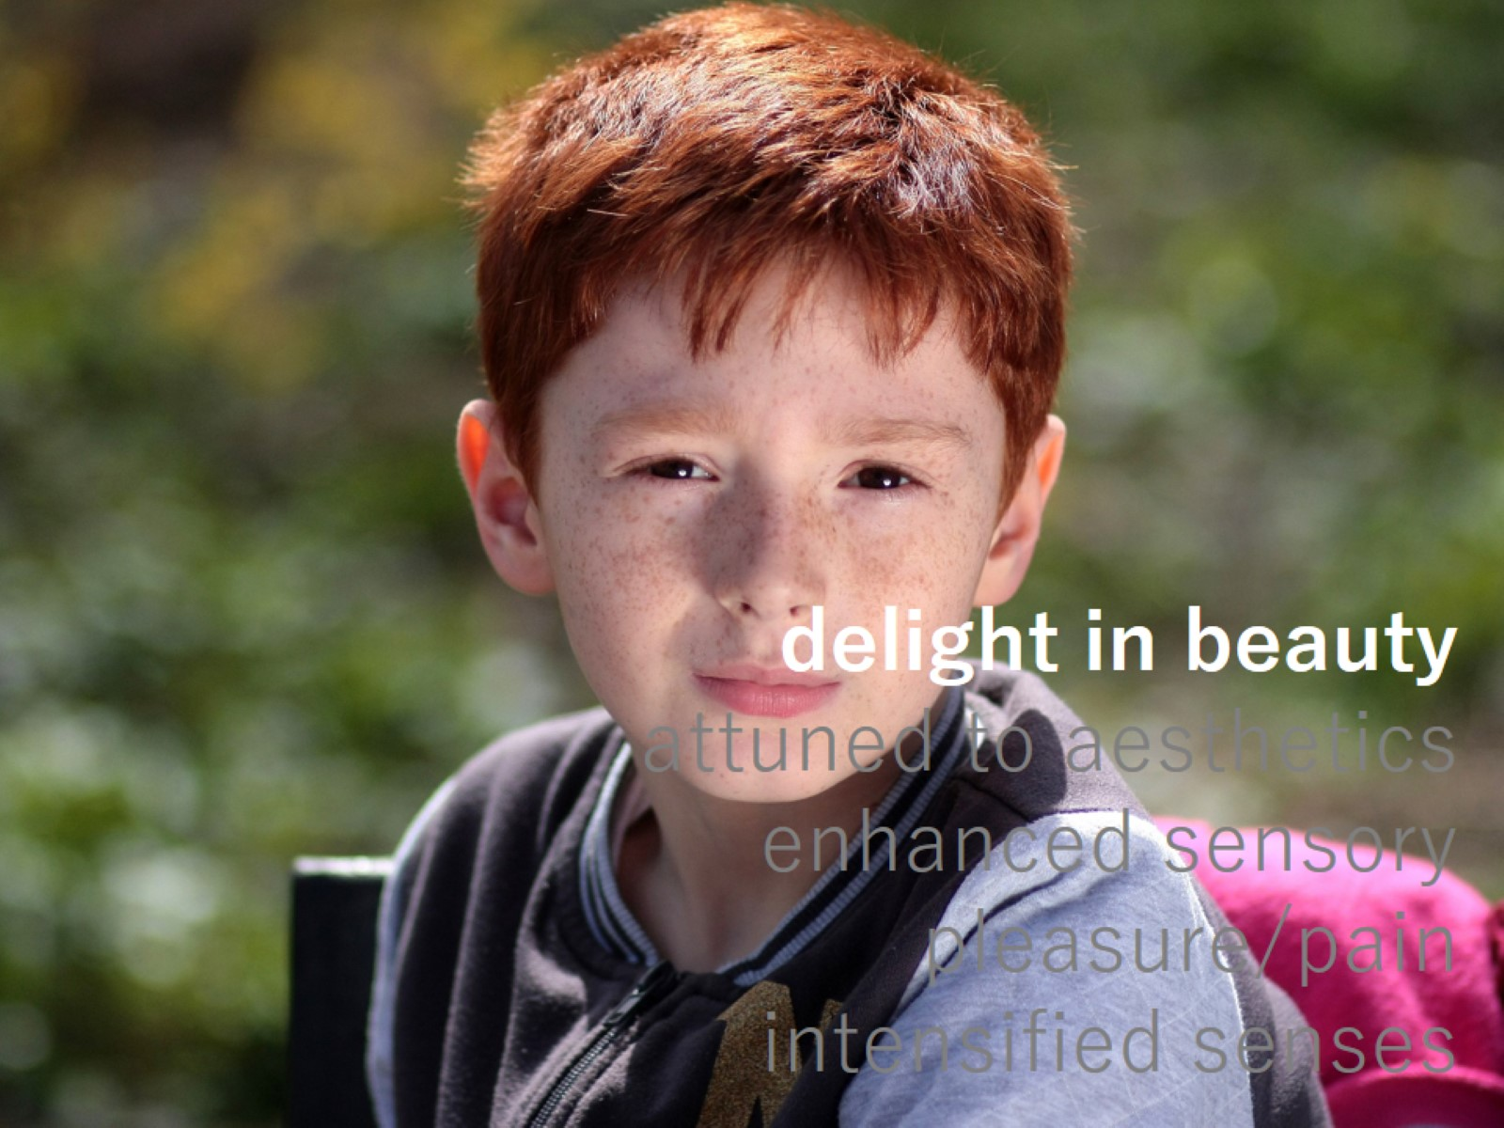
delight in beauty attuned to aesthetics enhanced sensory pleasure/pain intensified senses

Slide 27
delight in beauty attuned to aesthetics enhanced sensory pleasure/pain intensified senses

Slide 28
delight in beauty attuned to aesthetics enhanced sensory pleasure/pain intensified senses

Slide 29
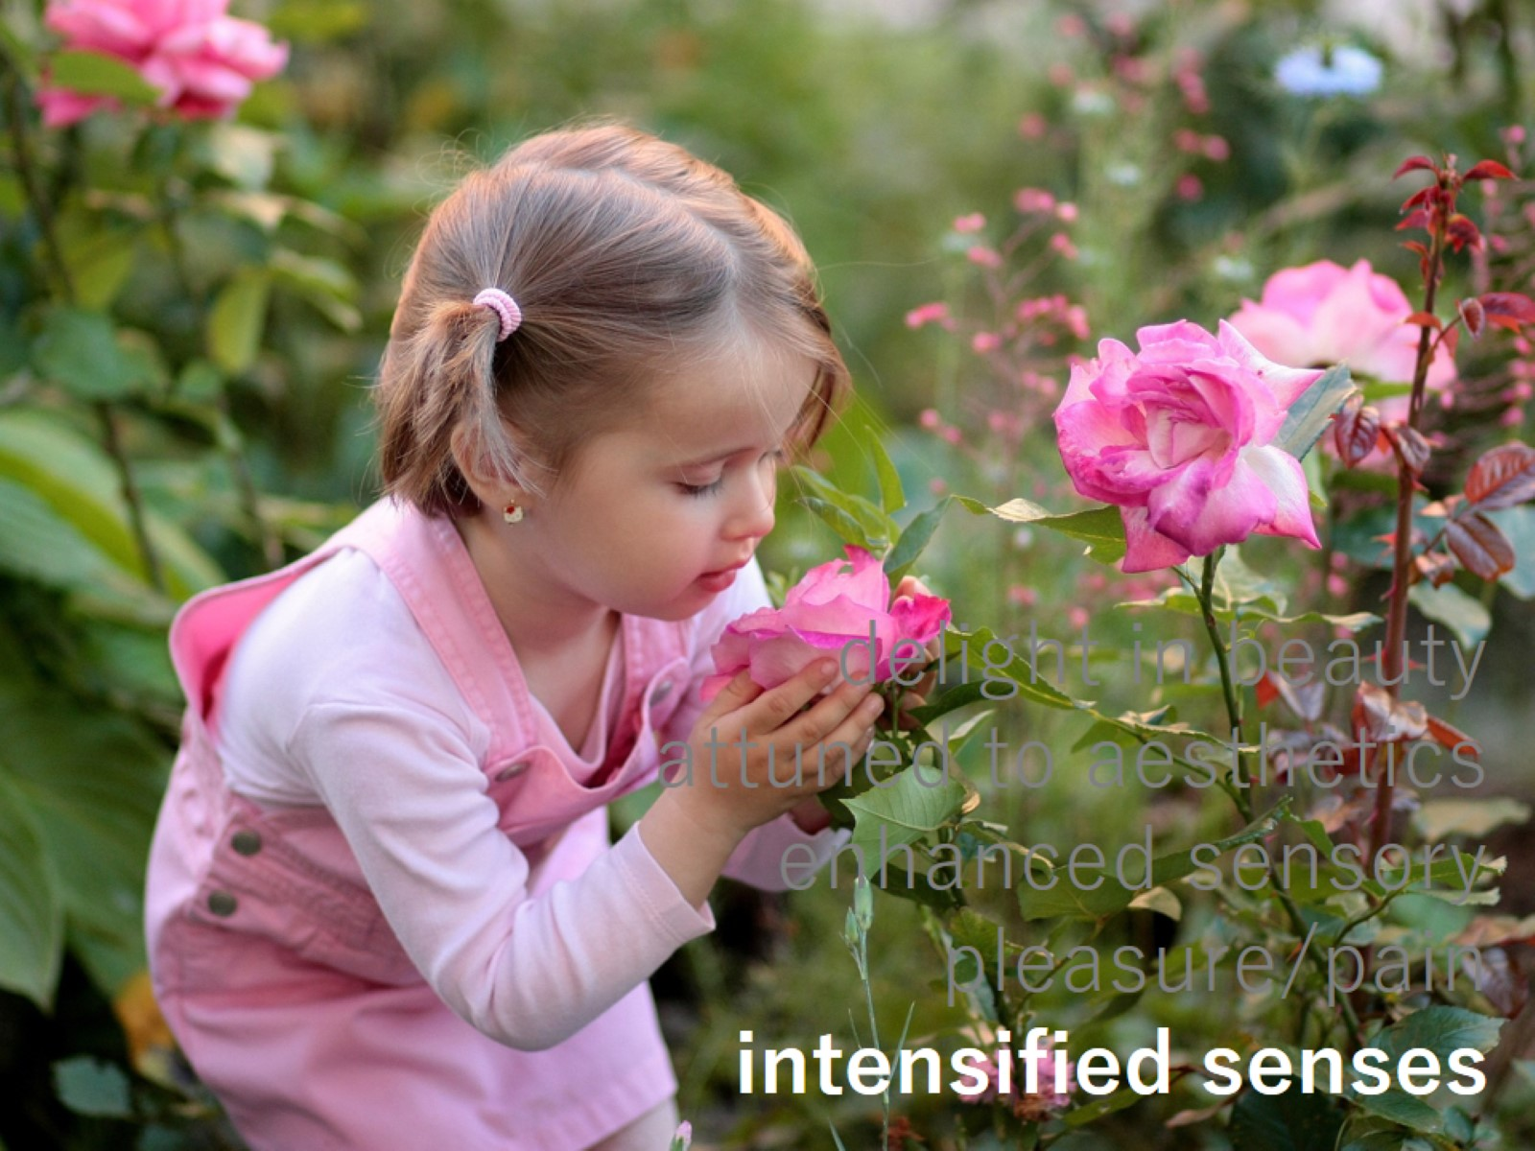
delight in beauty attuned to aesthetics enhanced sensory pleasure/pain intensified senses

Slide 30
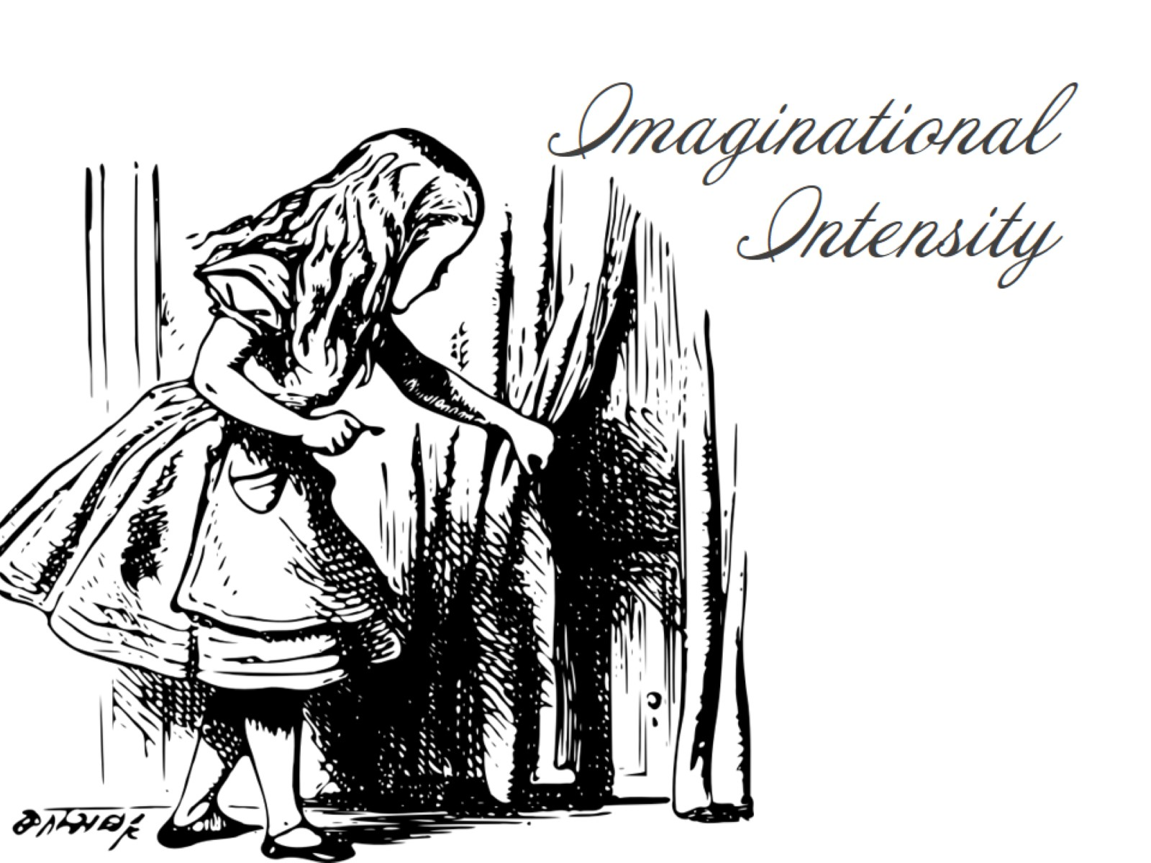
Imaginational Intensity

Slide 31
imaginary everything easily distracted by shiny ideas imaginative release of tension complicated relationship w/ truth imagery/metaphor complicated dreams confuse reality/fantasy daydreaming animistic imagery

Slide 32
imaginary everything easily distracted by shiny ideas imaginative release of tension complicated relationship w/ truth imagery/metaphor complicated dreams confuse reality/fantasy daydreaming animistic imagery

Slide 33
imaginary everything easily distracted by shiny ideas imaginative release of tension complicated relationship w/ truth imagery/metaphor complicated dreams confuse reality/fantasy daydreaming animistic imagery

Slide 34
imaginary everything easily distracted by shiny ideas imaginative release of tension complicated relationship w/ truth imagery/metaphor complicated dreams confuse reality/fantasy daydreaming animistic imagery

Slide 35
imaginary everything easily distracted by shiny ideas imaginative release of tension complicated relationship w/ truth imagery/metaphor complicated dreams confuse reality/fantasy daydreaming animistic imagery

Slide 36
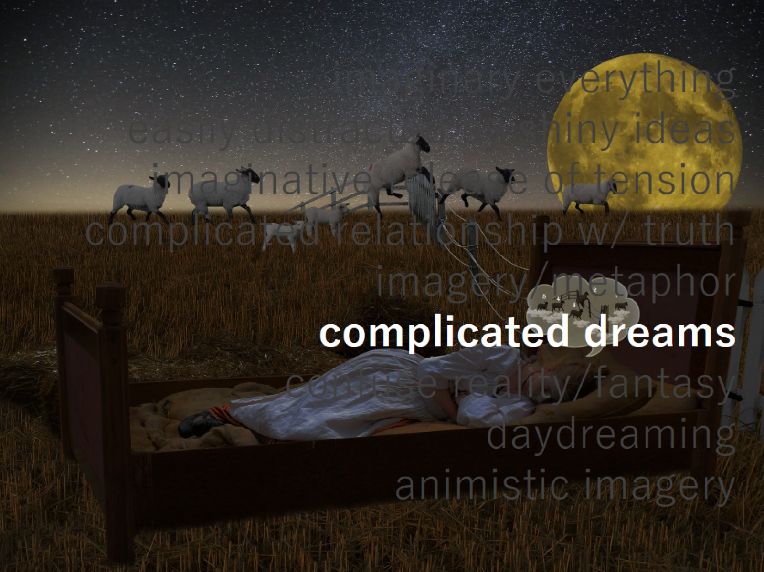
imaginary everything easily distracted by shiny ideas imaginative release of tension complicated relationship w/ truth imagery/metaphor complicated dreams confuse reality/fantasy daydreaming animistic imagery

Slide 37
imaginary everything easily distracted by shiny ideas imaginative release of tension complicated relationship w/ truth imagery/metaphor complicated dreams confuse reality/fantasy daydreaming animistic imagery

Slide 38
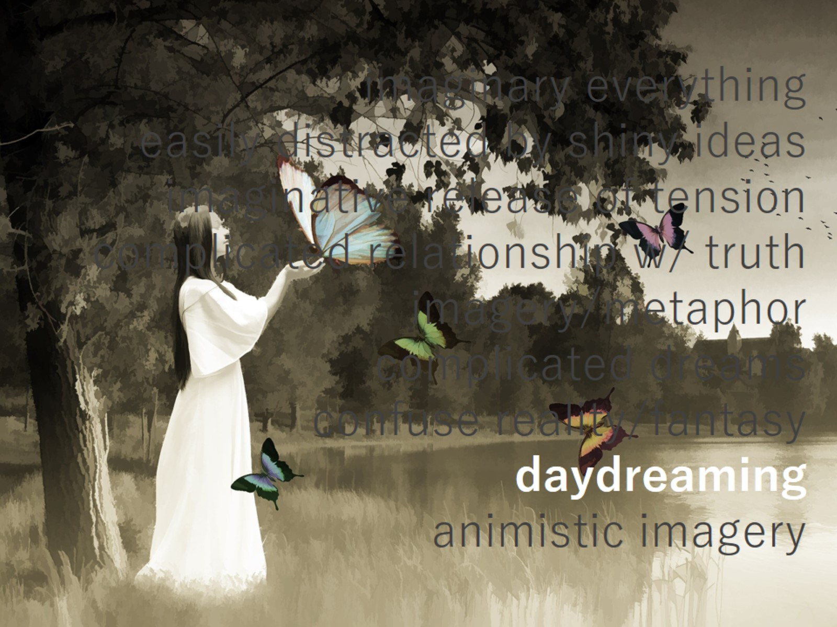
imaginary everything easily distracted by shiny ideas imaginative release of tension complicated relationship w/ truth imagery/metaphor complicated dreams confuse reality/fantasy daydreaming animistic imagery

Slide 39
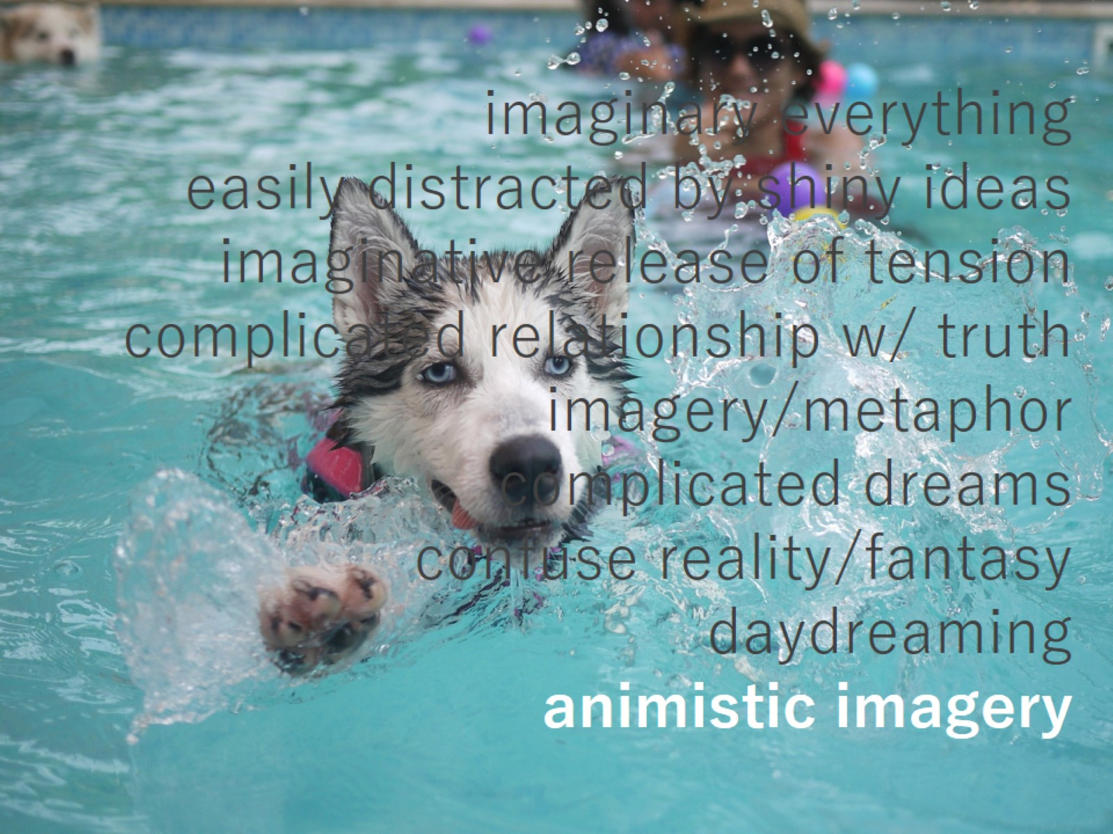
imaginary everything easily distracted by shiny ideas imaginative release of tension complicated relationship w/ truth imagery/metaphor complicated dreams confuse reality/fantasy daydreaming animistic imagery

Slide 40
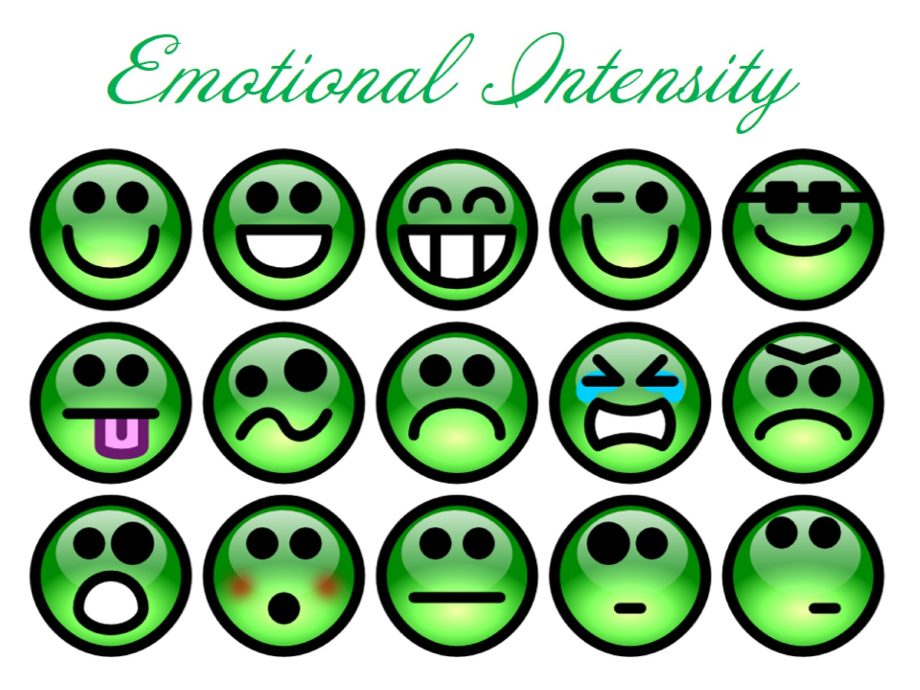
Emotional Intensity

Slide 41
intense feeling [happy/sad] paralyzing compassion strong emotional attachments overreaction physical manifestation of emotion self-critical strong affective memory

Slide 42
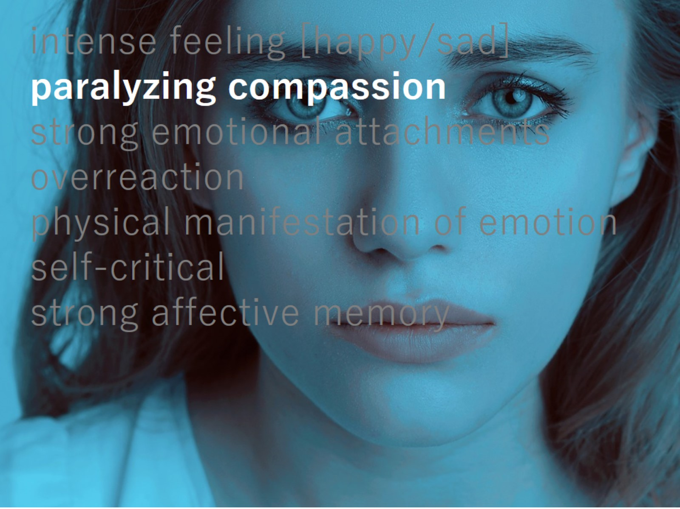
intense feeling [happy/sad] paralyzing compassion strong emotional attachments overreaction physical manifestation of emotion self-critical strong affective memory

Slide 43
intense feeling [happy/sad] paralyzing compassion strong emotional attachments overreaction physical manifestation of emotion self-critical strong affective memory

Slide 44
intense feeling [happy/sad] paralyzing compassion strong emotional attachments overreaction physical manifestation of emotion self-critical strong affective memory

Slide 45
intense feeling [happy/sad] paralyzing compassion strong emotional attachments overreaction physical manifestation of emotion self-critical strong affective memory

Slide 46
intense feeling [happy/sad] paralyzing compassion strong emotional attachments overreaction physical manifestation of emotion self-critical strong affective memory

Slide 47
intense feeling [happy/sad] paralyzing compassion strong emotional attachments overreaction physical manifestation of emotion self-critical strong affective memory

Slide 49
Part 2: The ELA Classroom

Slide 50
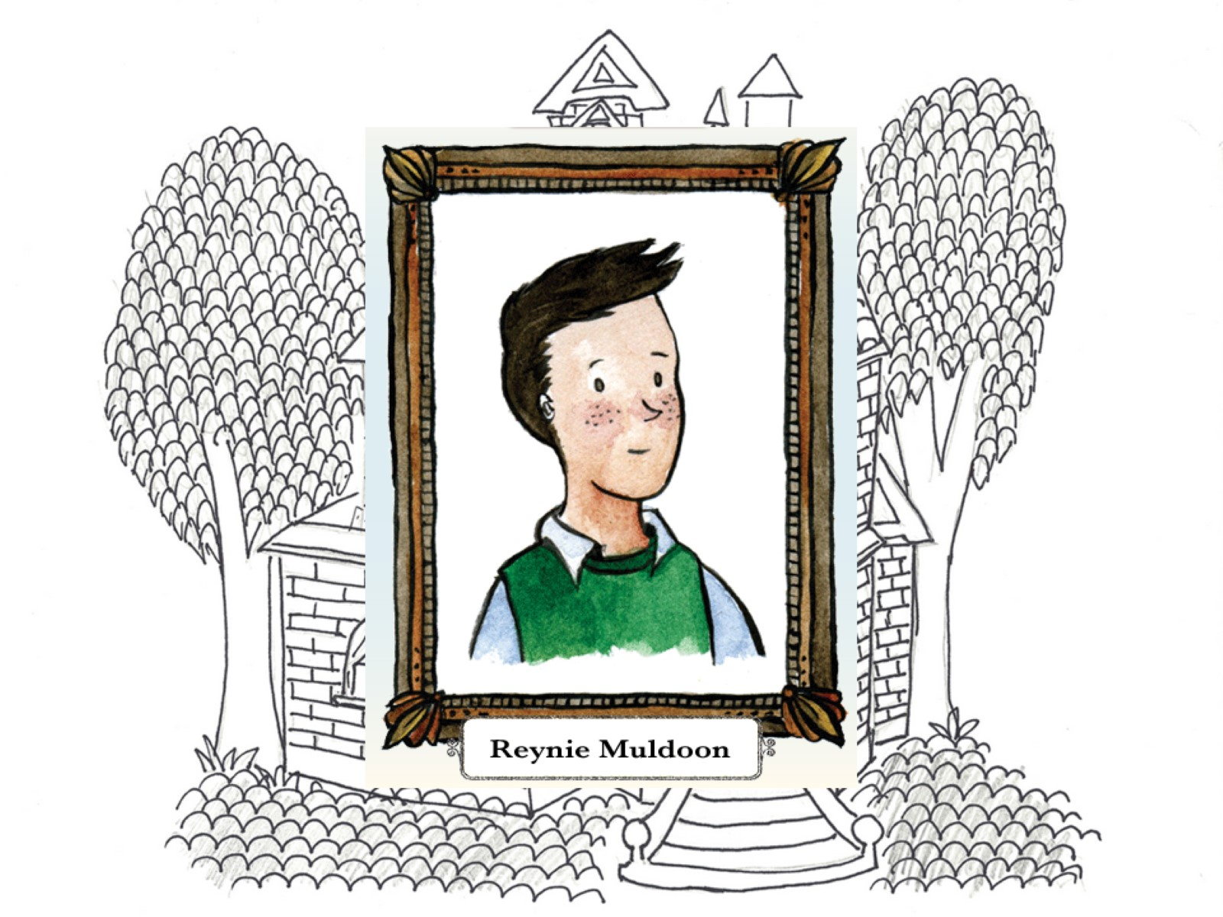

Slide 52
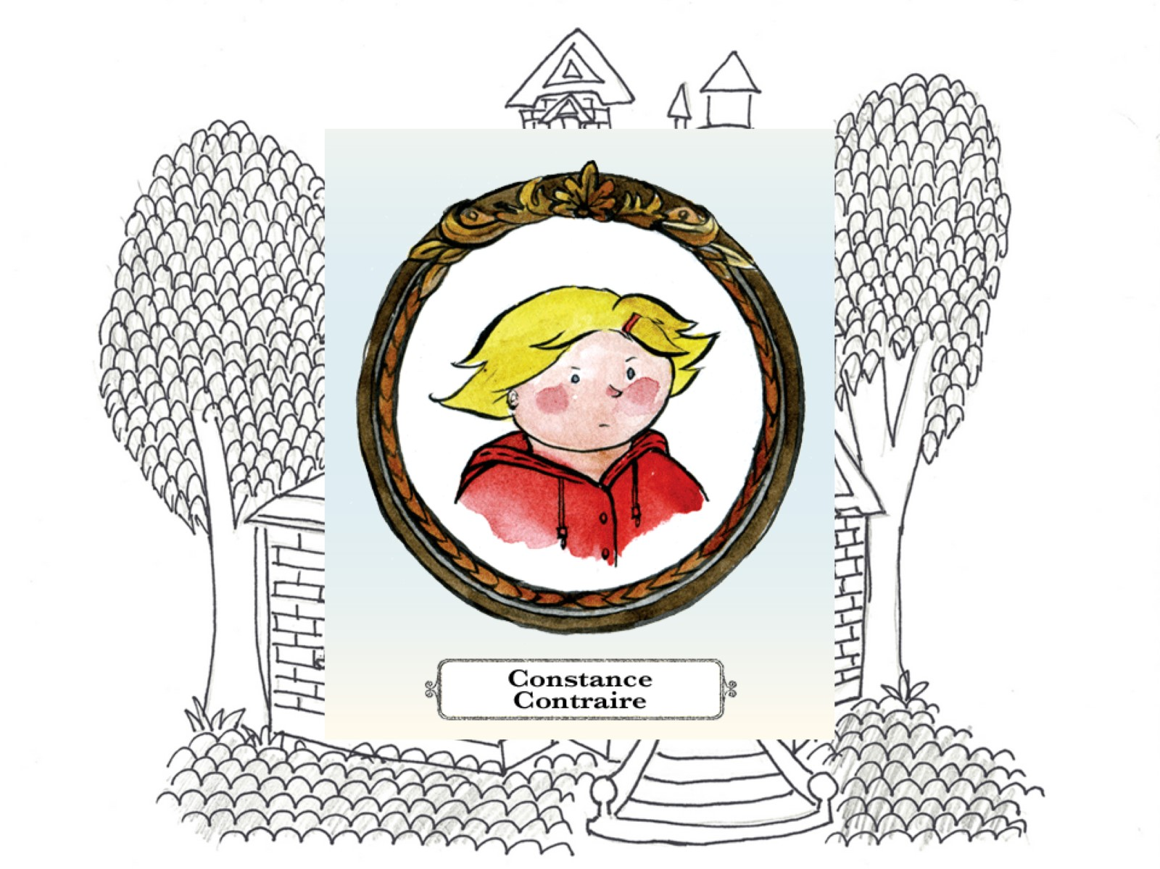

Slide 54
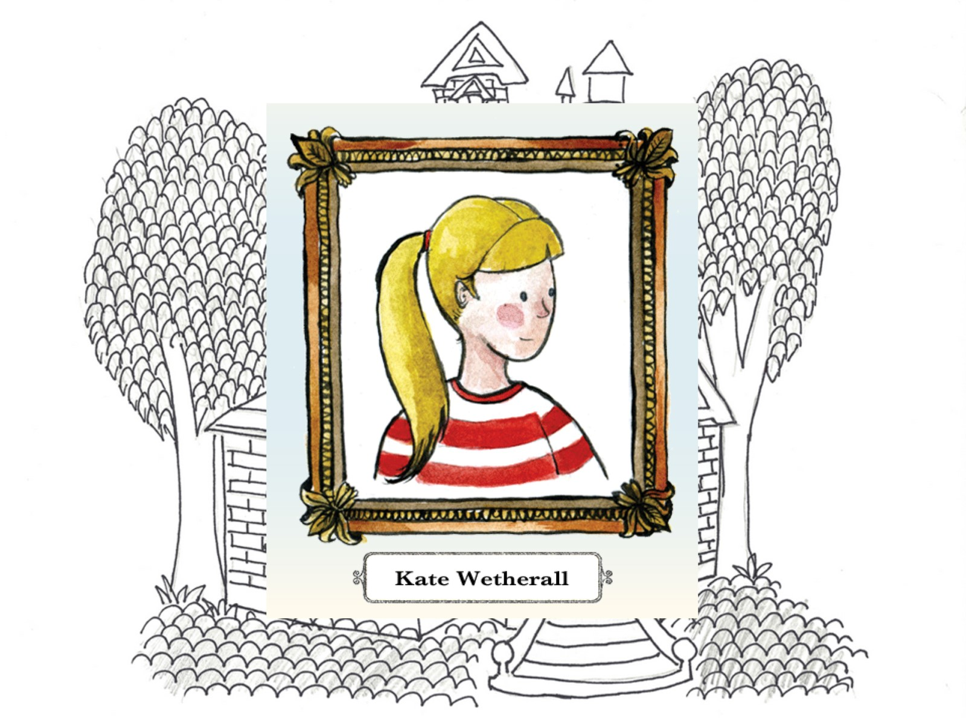

Slide 56
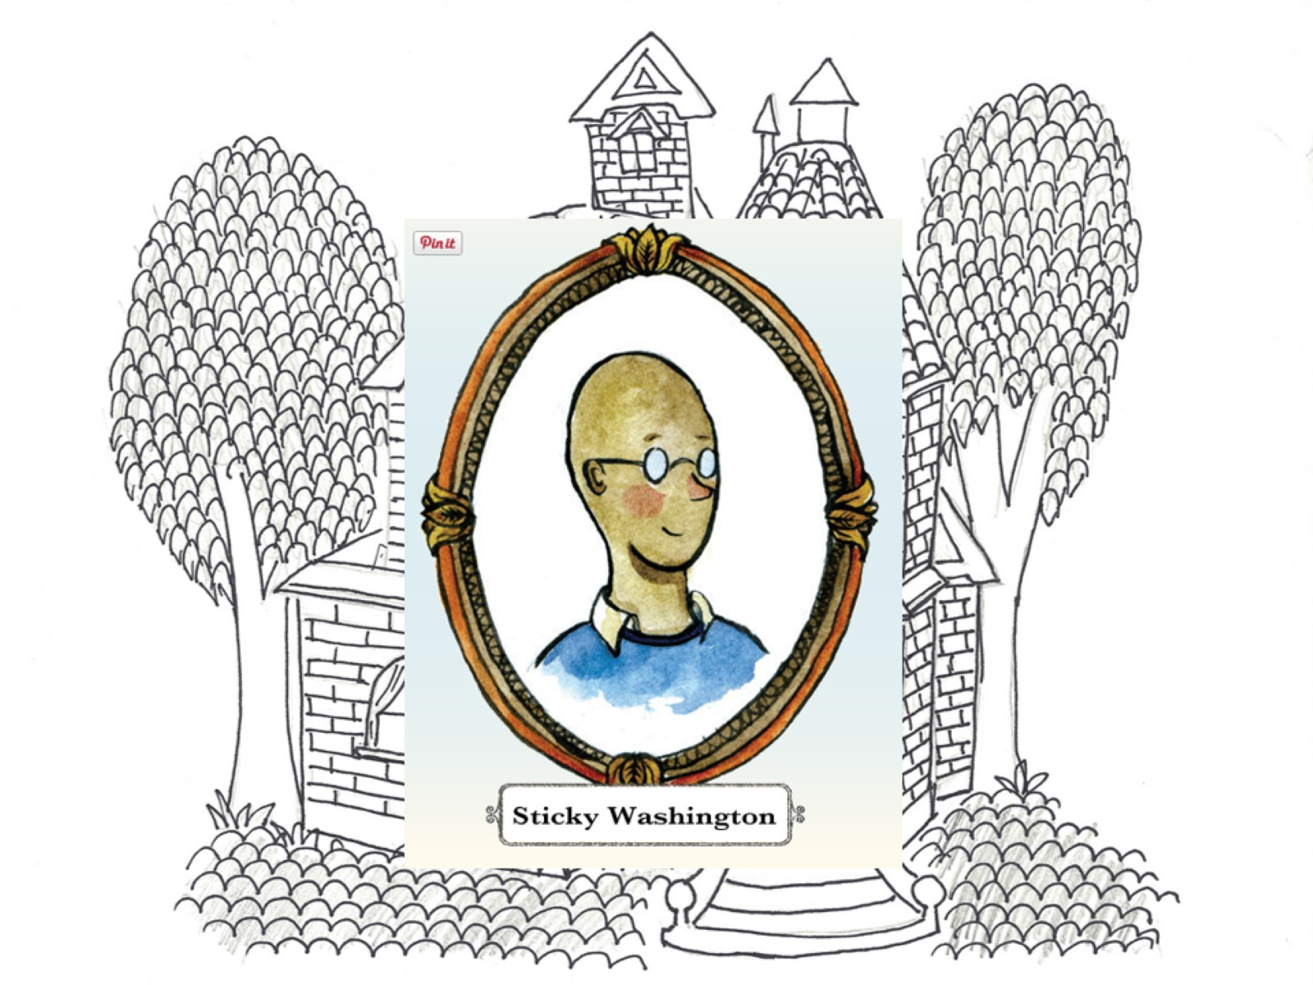

Slide 58
OVEREXCITABILITIES, a.k.a. INTENSITIES

Slide 59
Psychomotor Intensity

Slide 61
Sensual Intensity

Slide 64
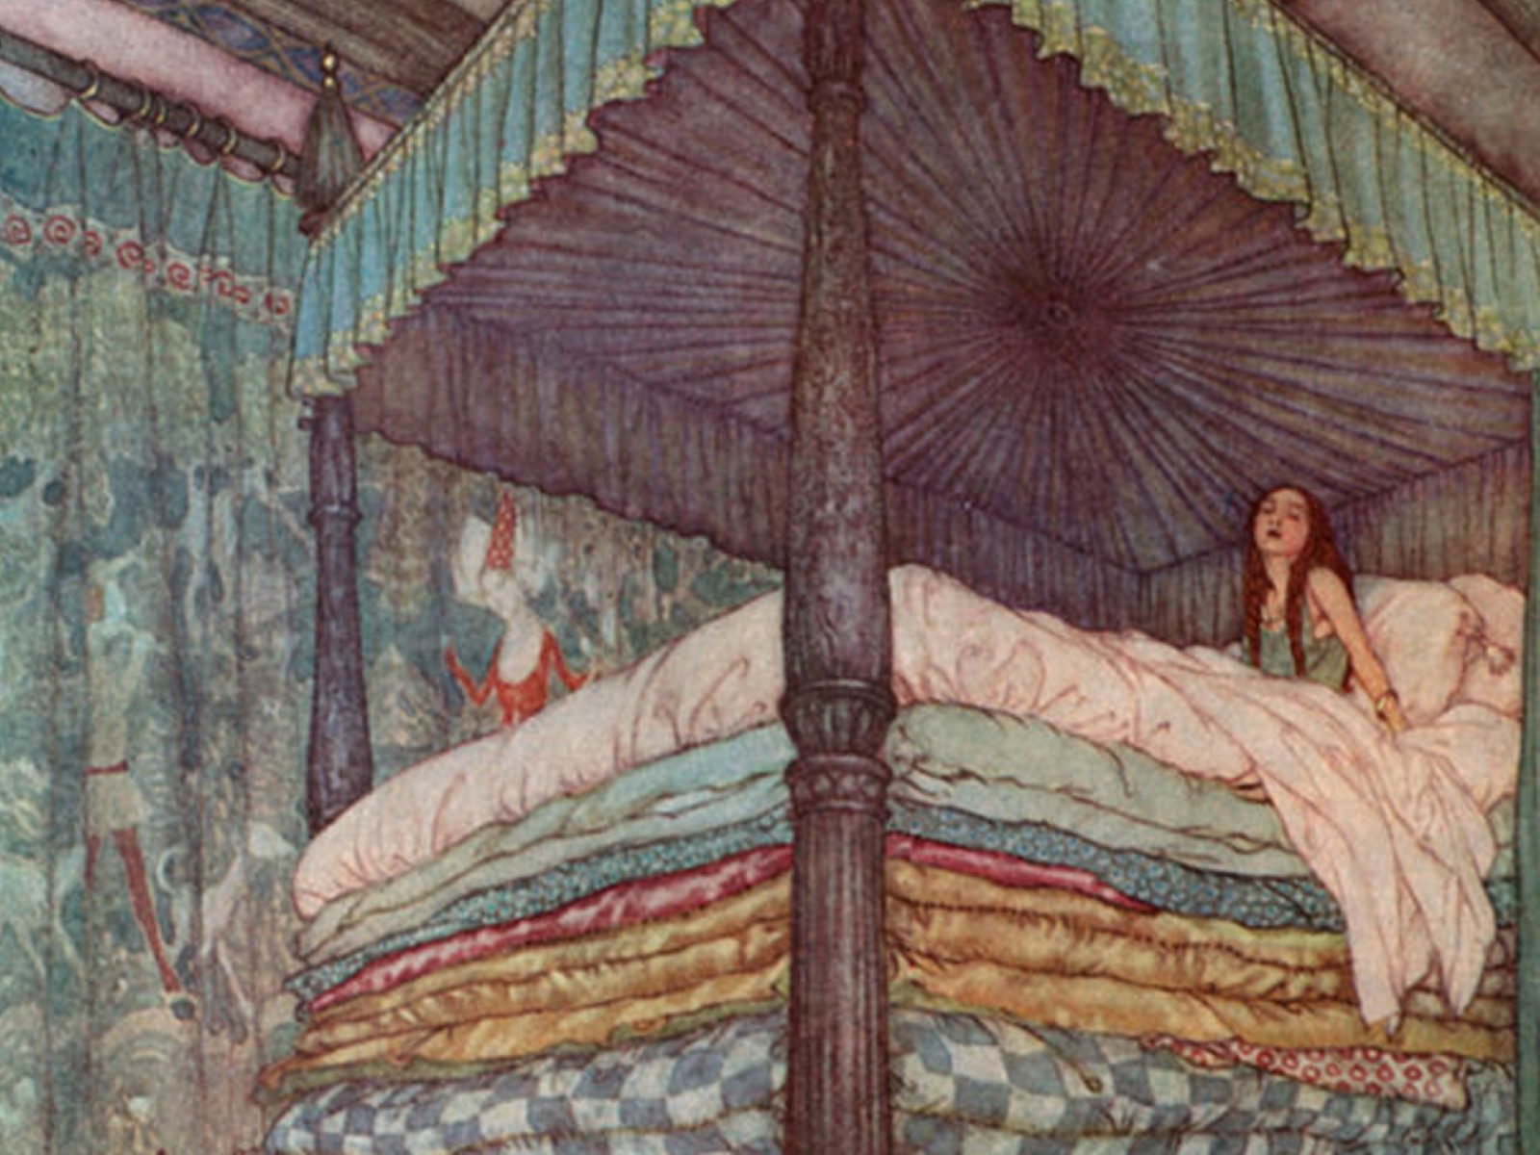

Slide 65
Intellectual Intensity

Slide 66
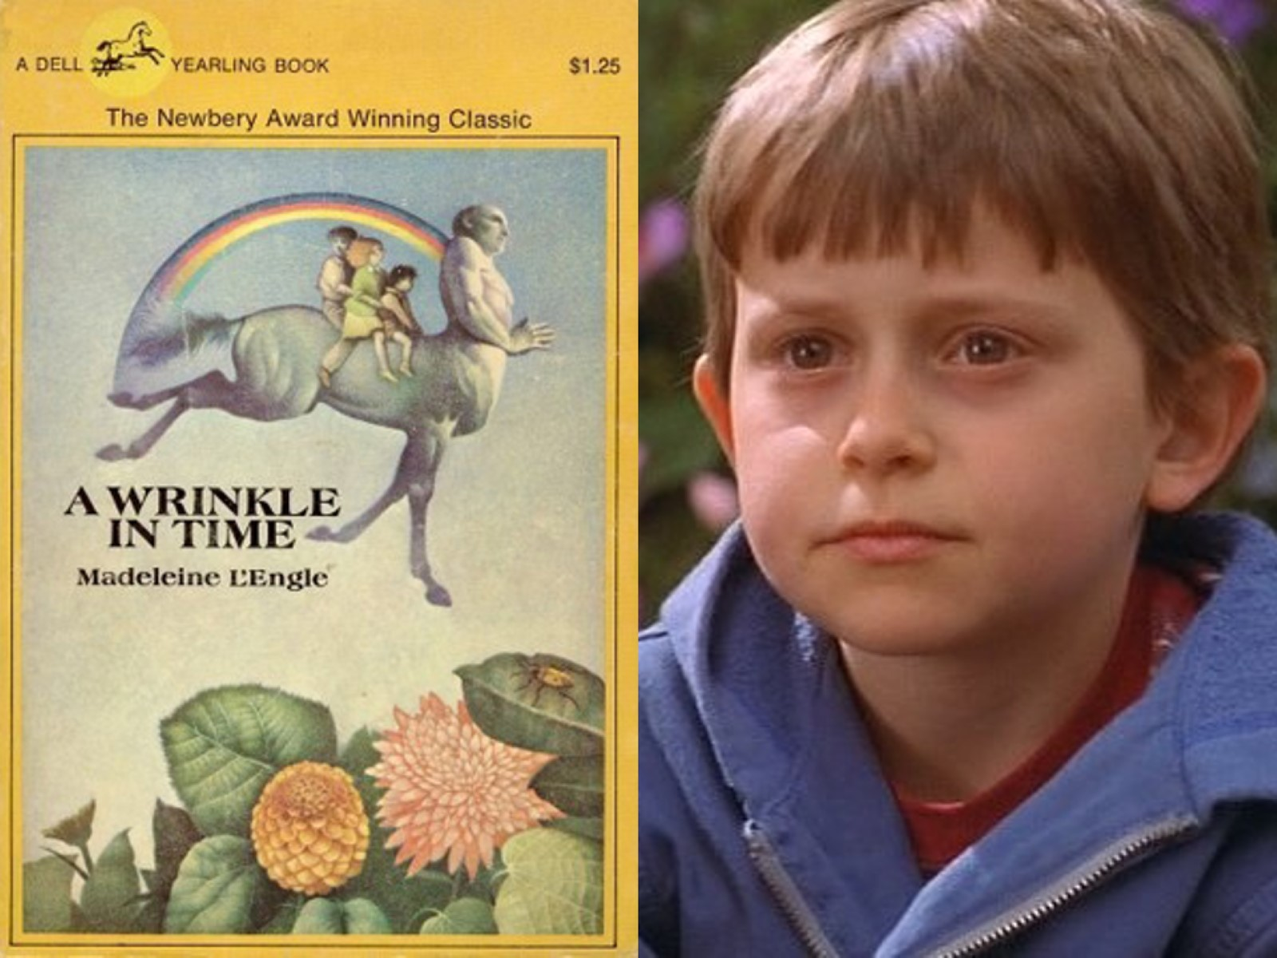

Slide 68
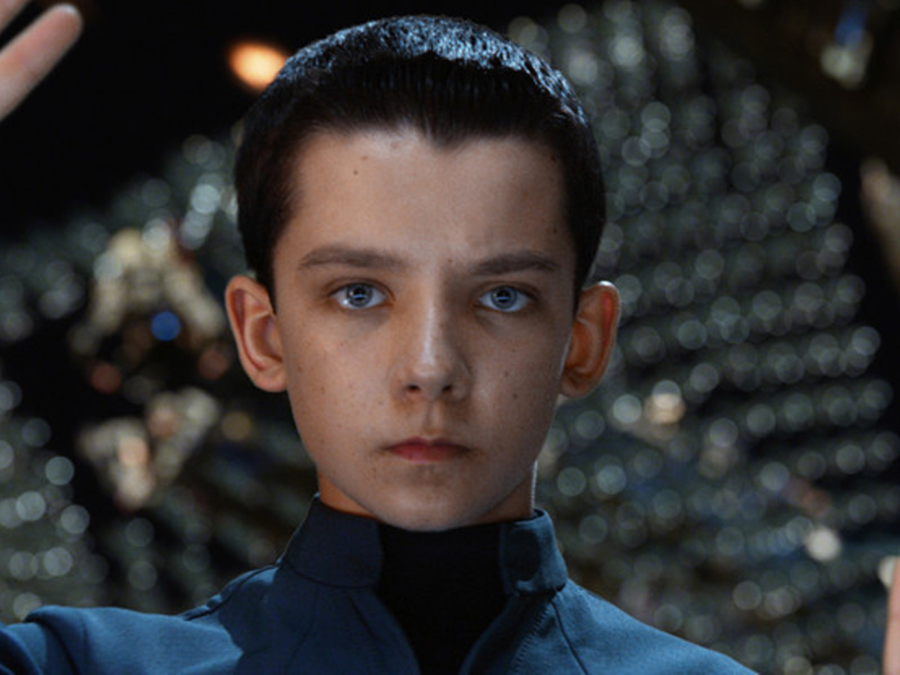

Slide 69
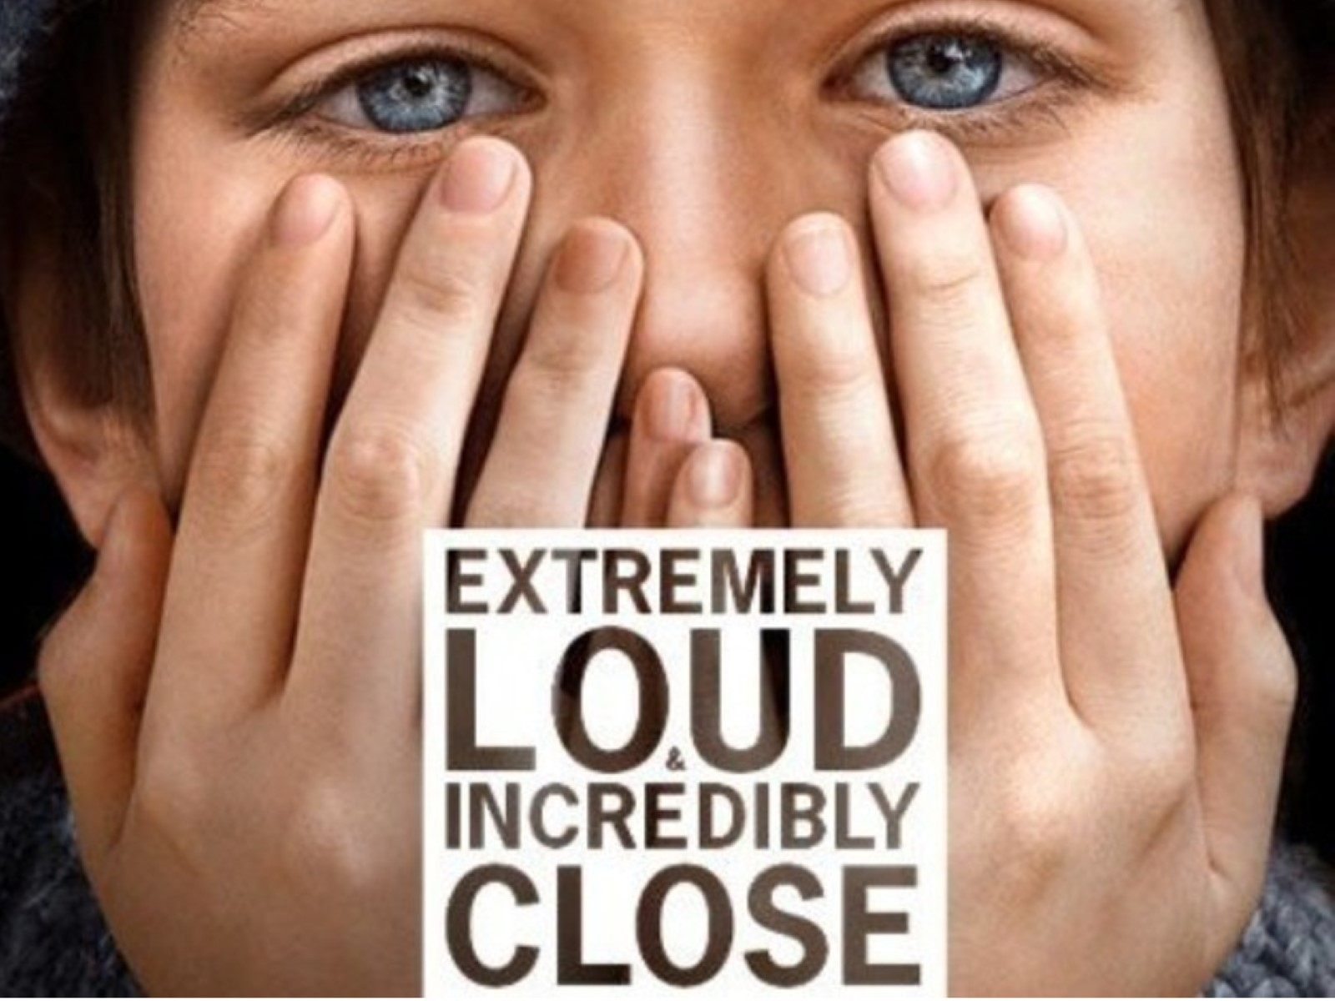

Slide 71
Imaginational Intensity

Slide 73
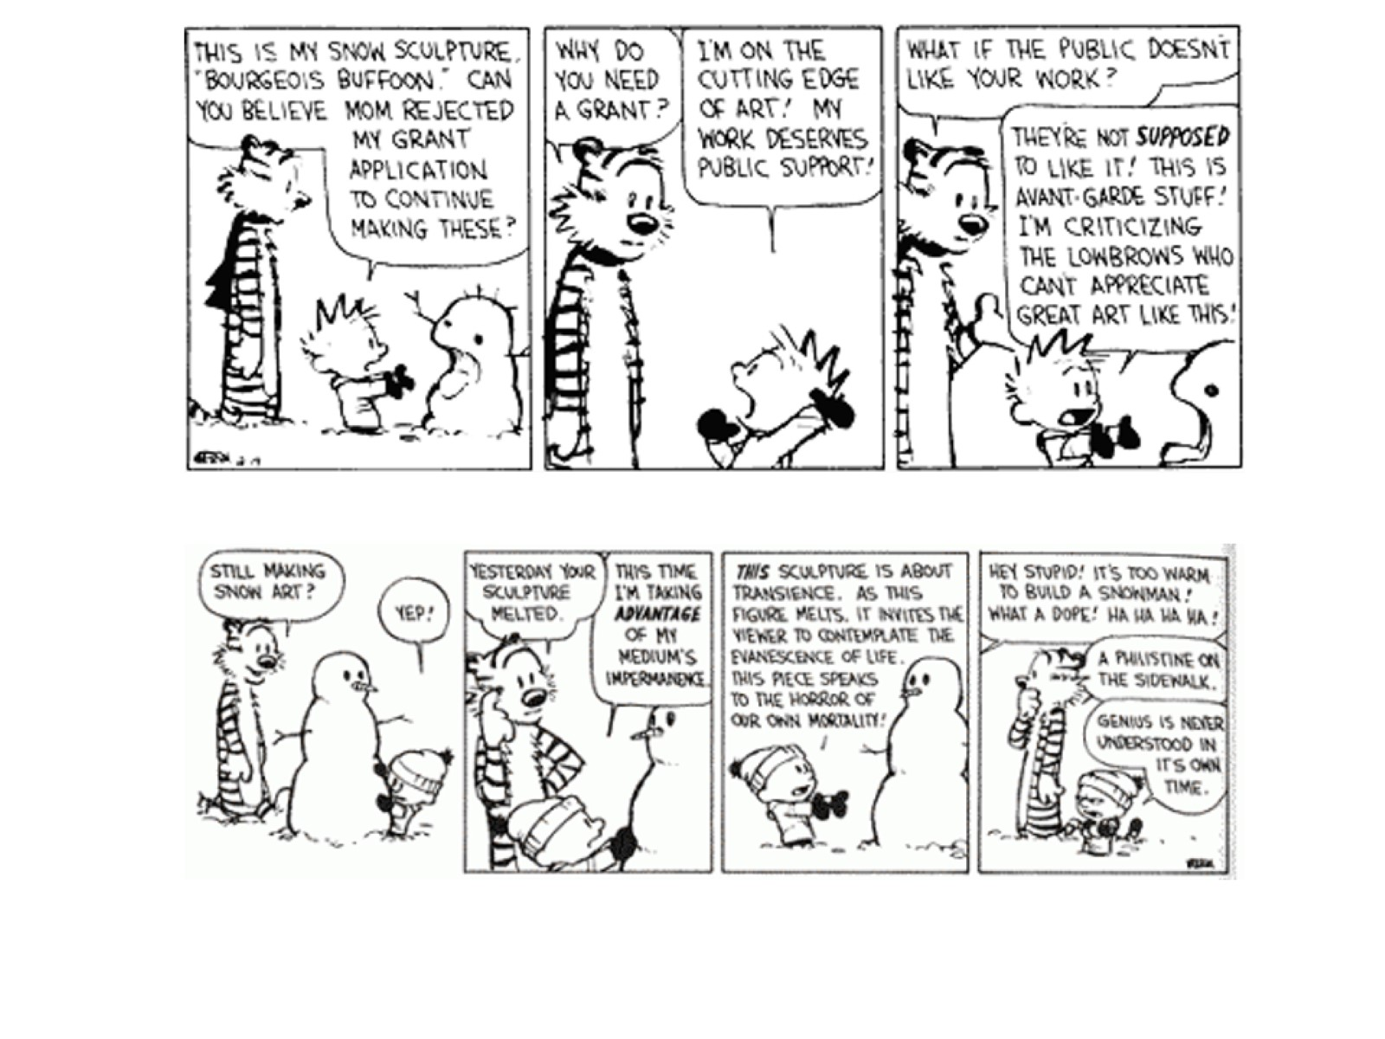

Slide 74
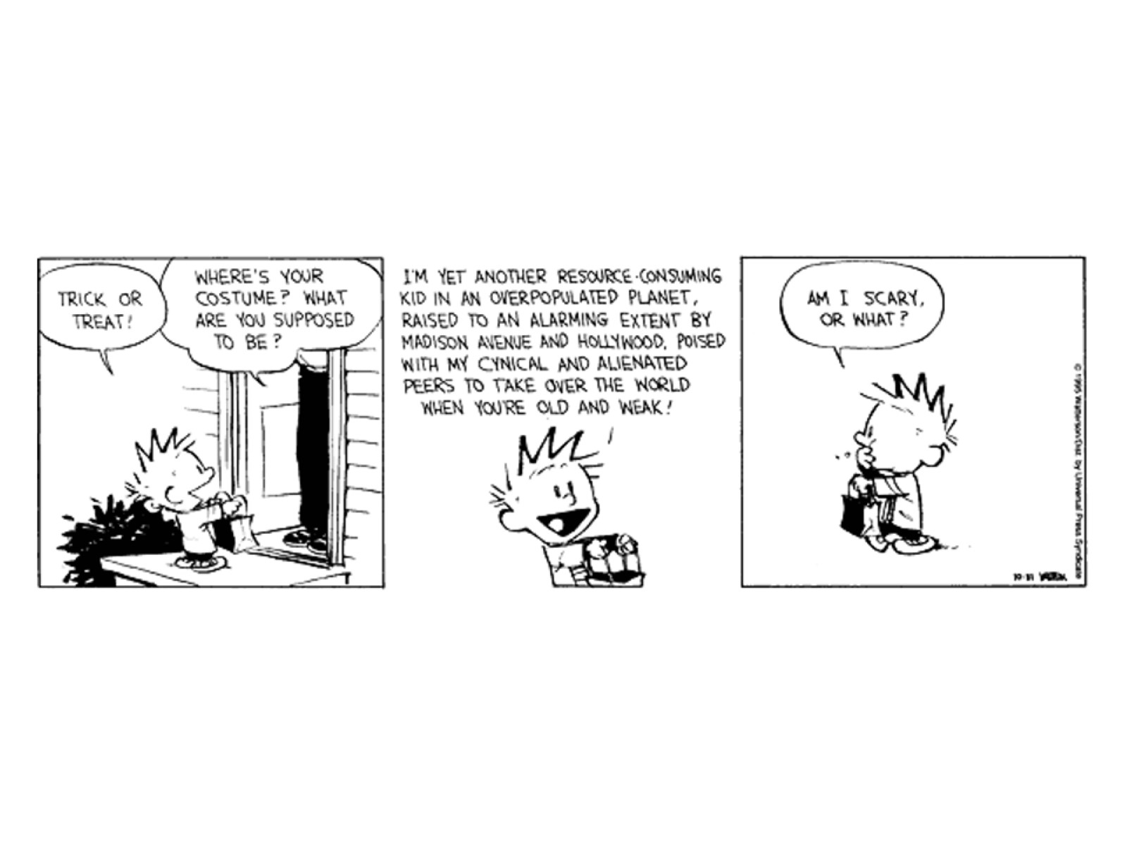

Slide 75
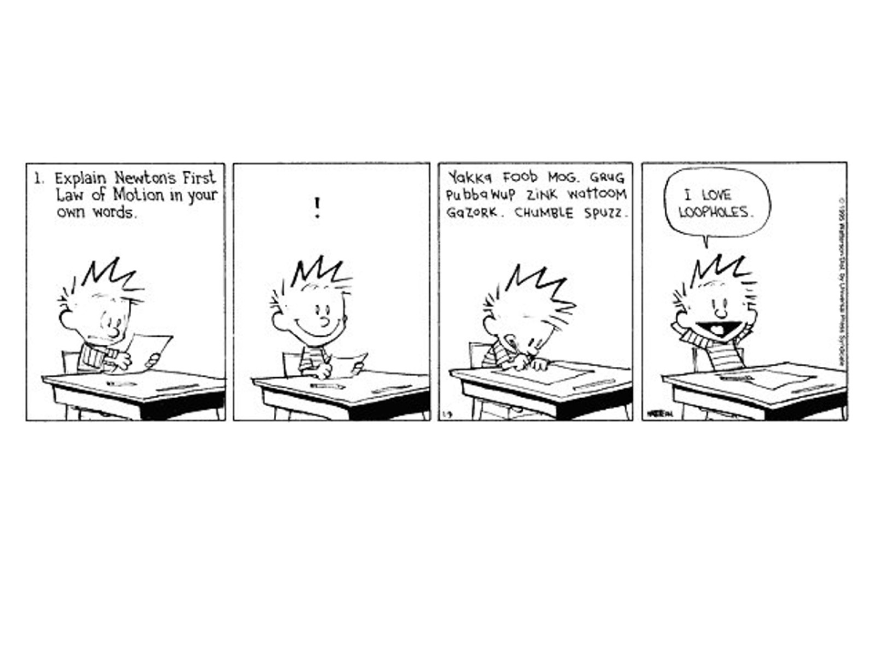

Slide 76
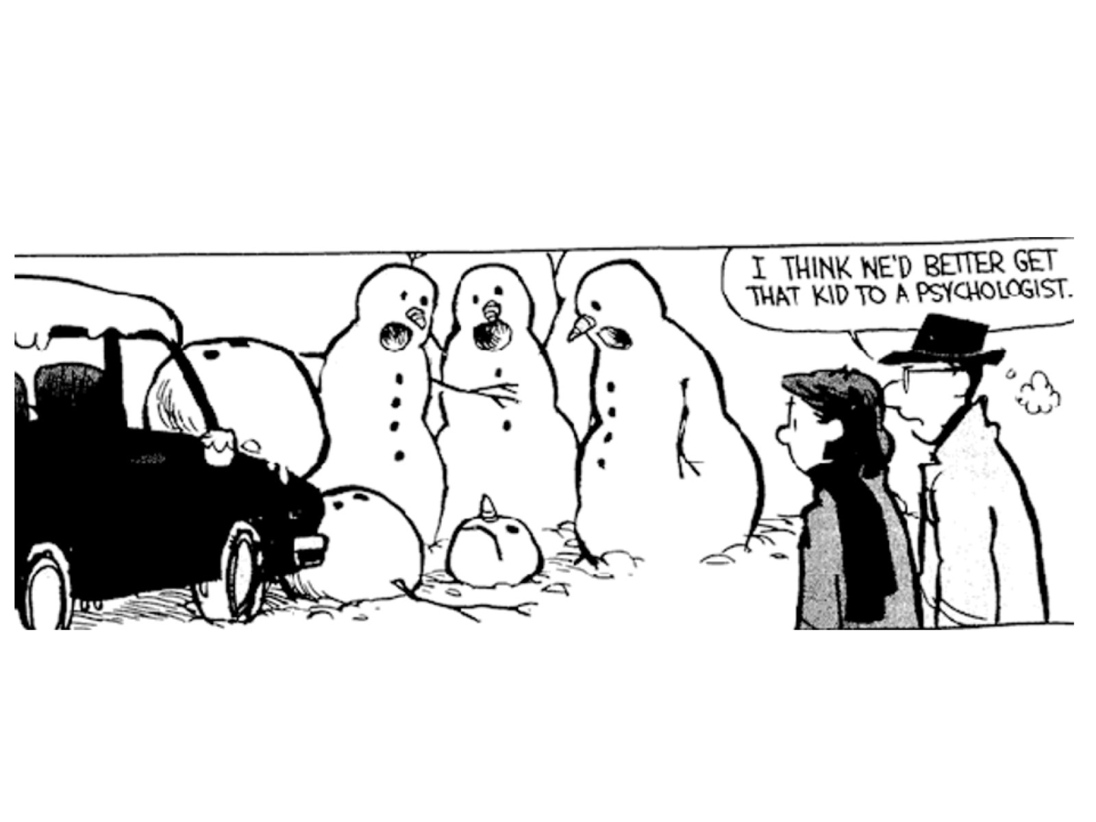

Slide 78
Part 3: Other Content Areas

Slide 81
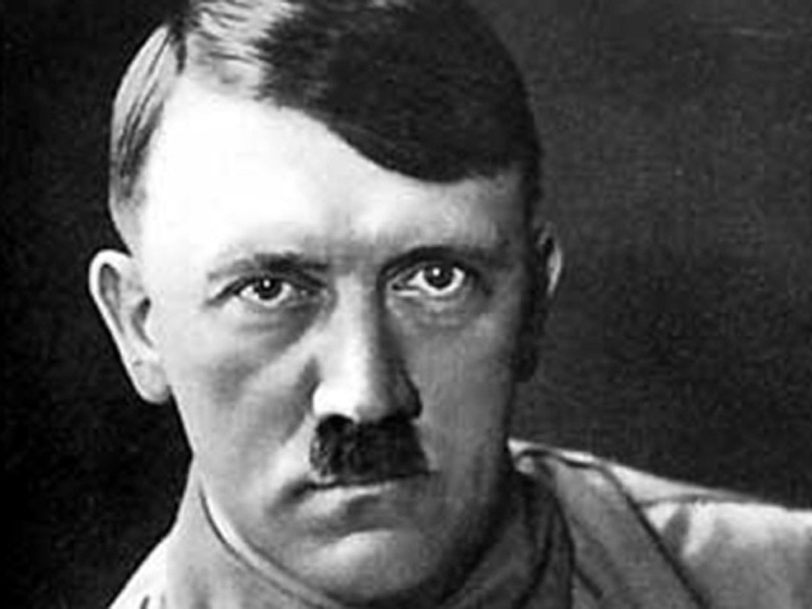

Slide 82
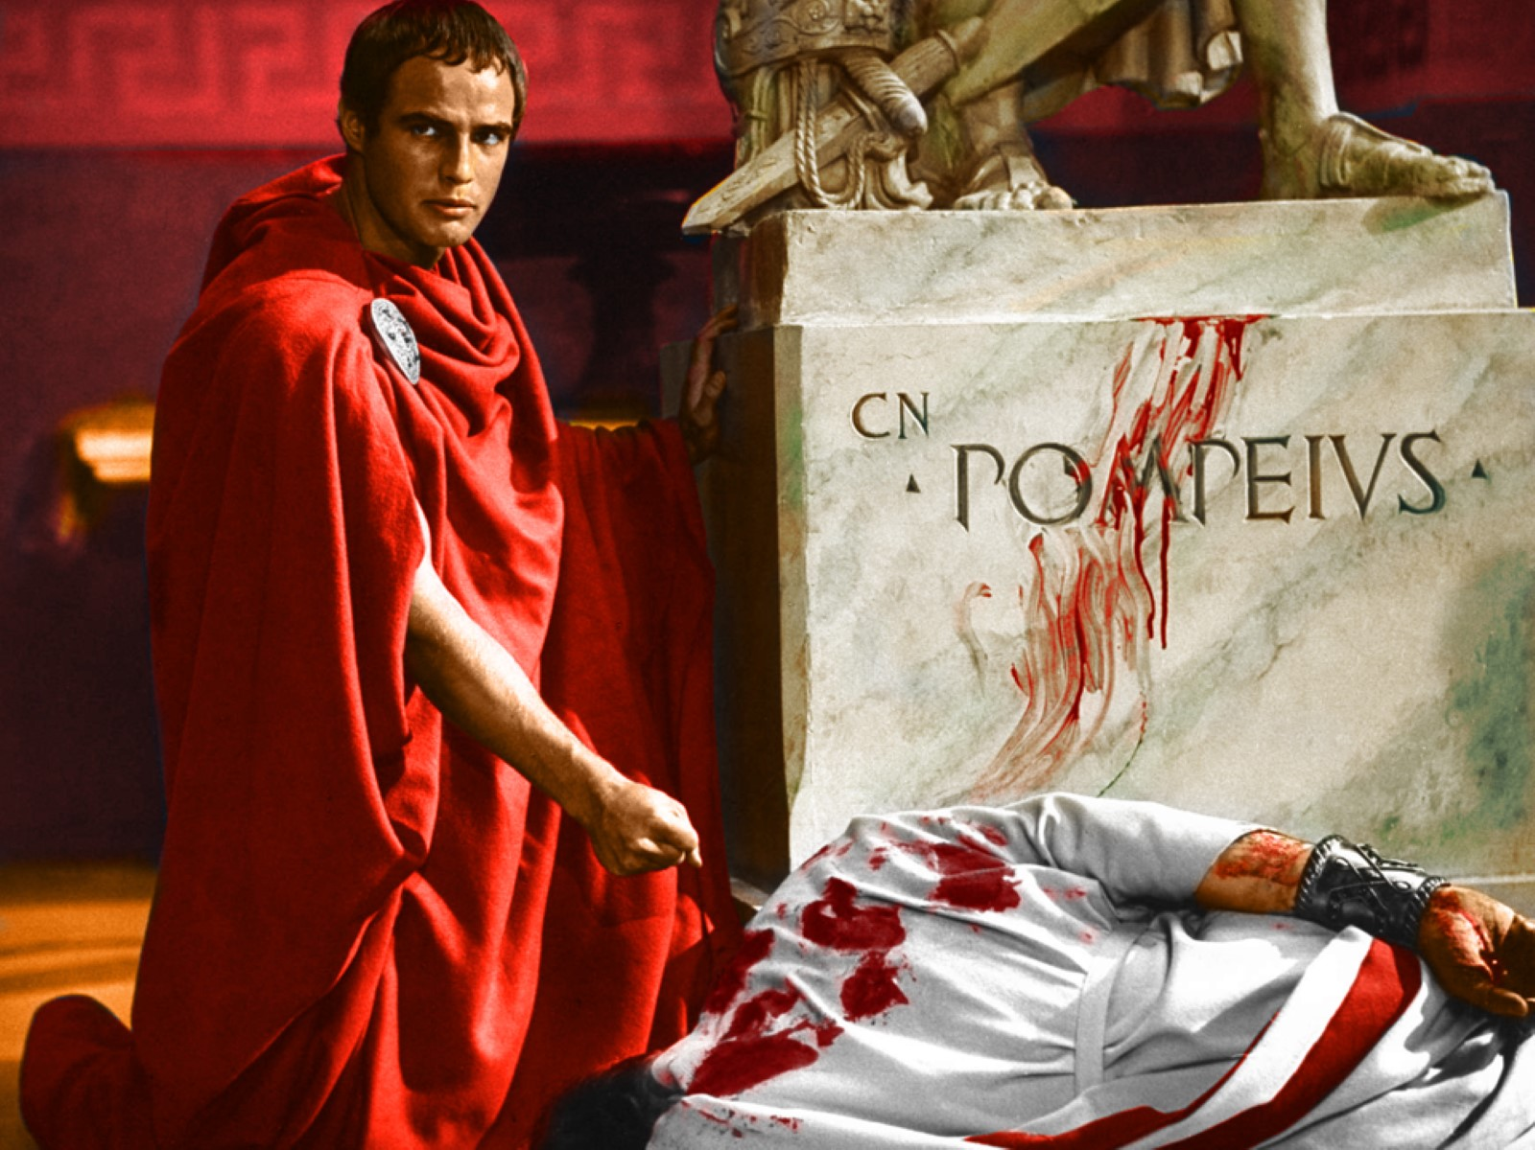

Slide 83
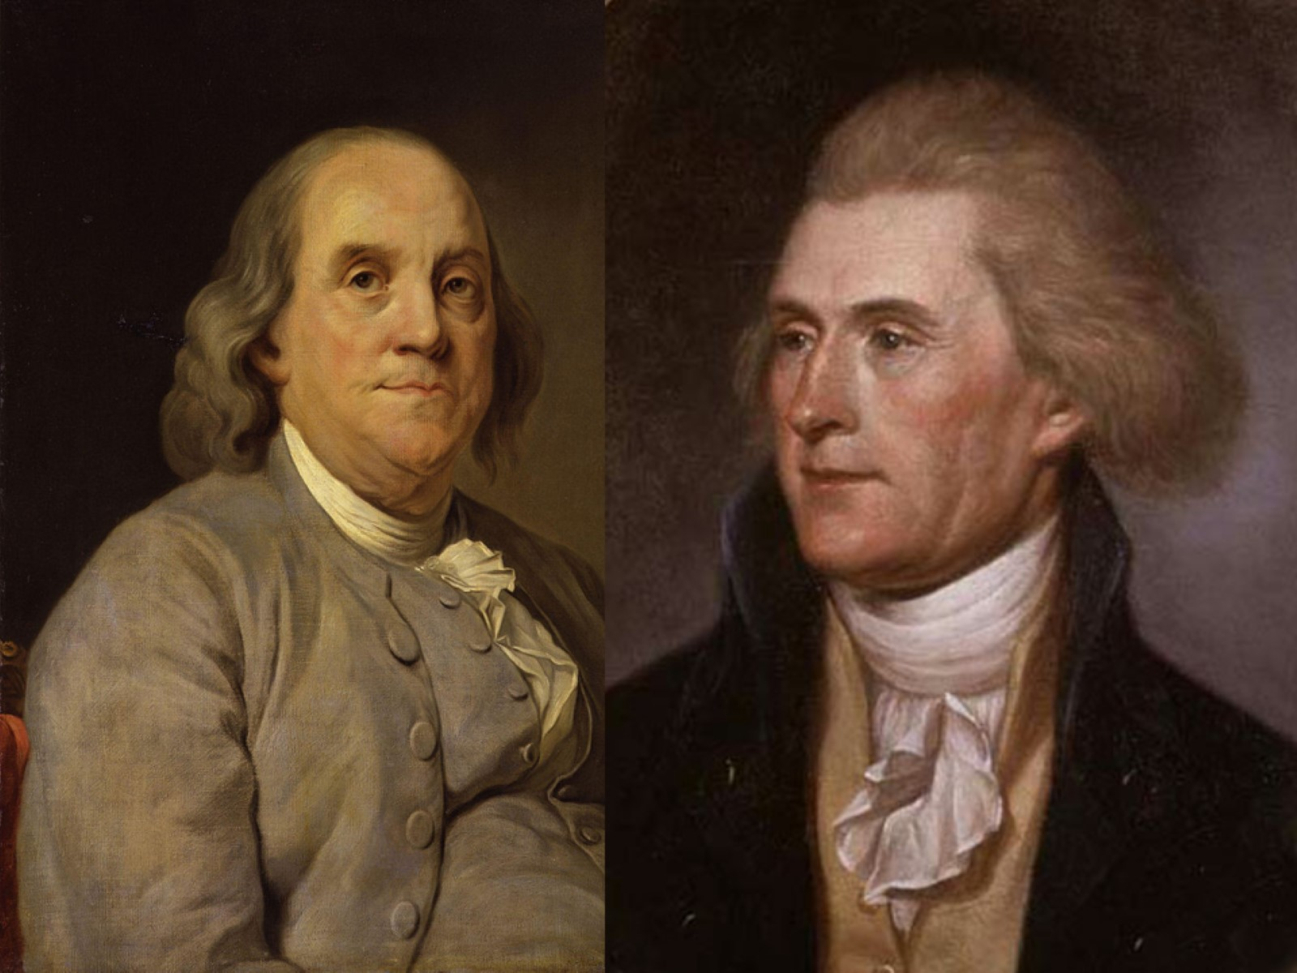

Slide 85
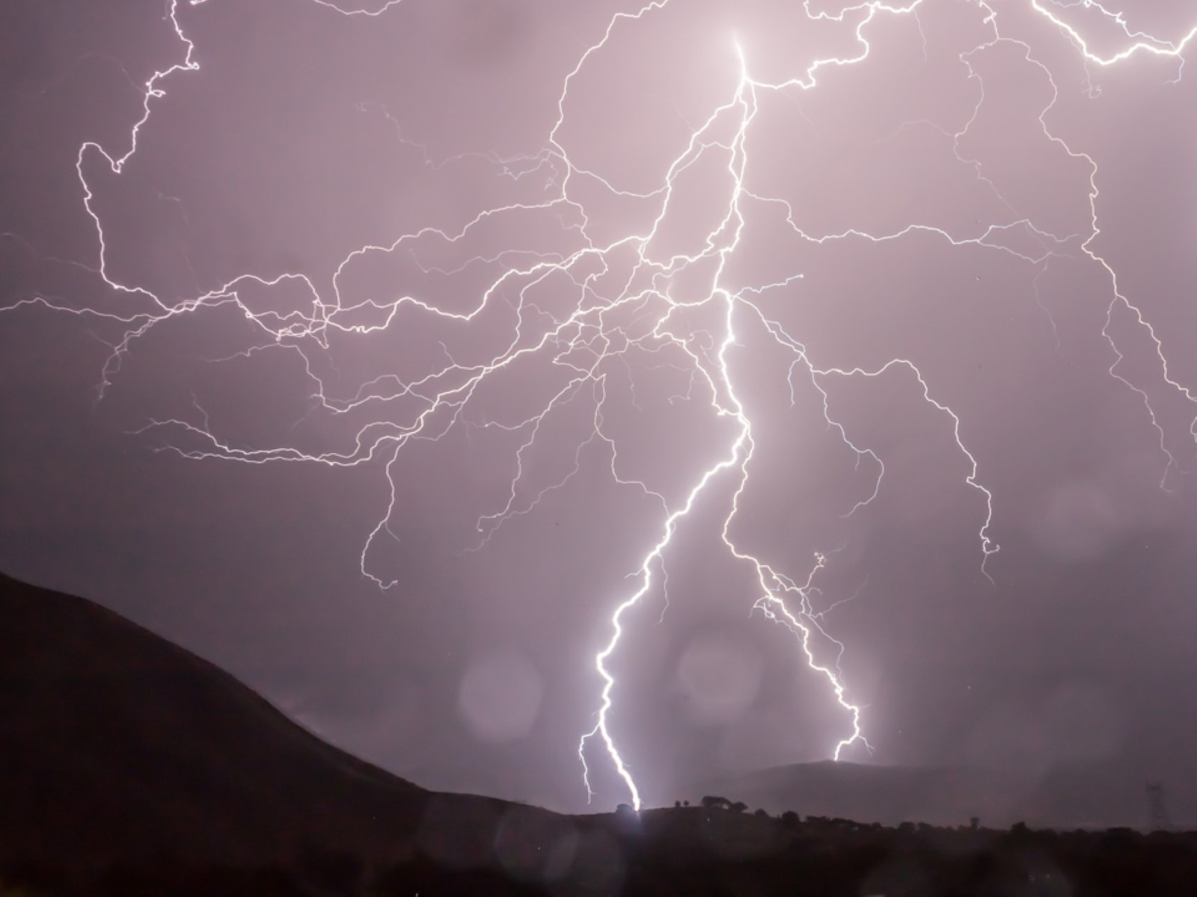

Slide 87
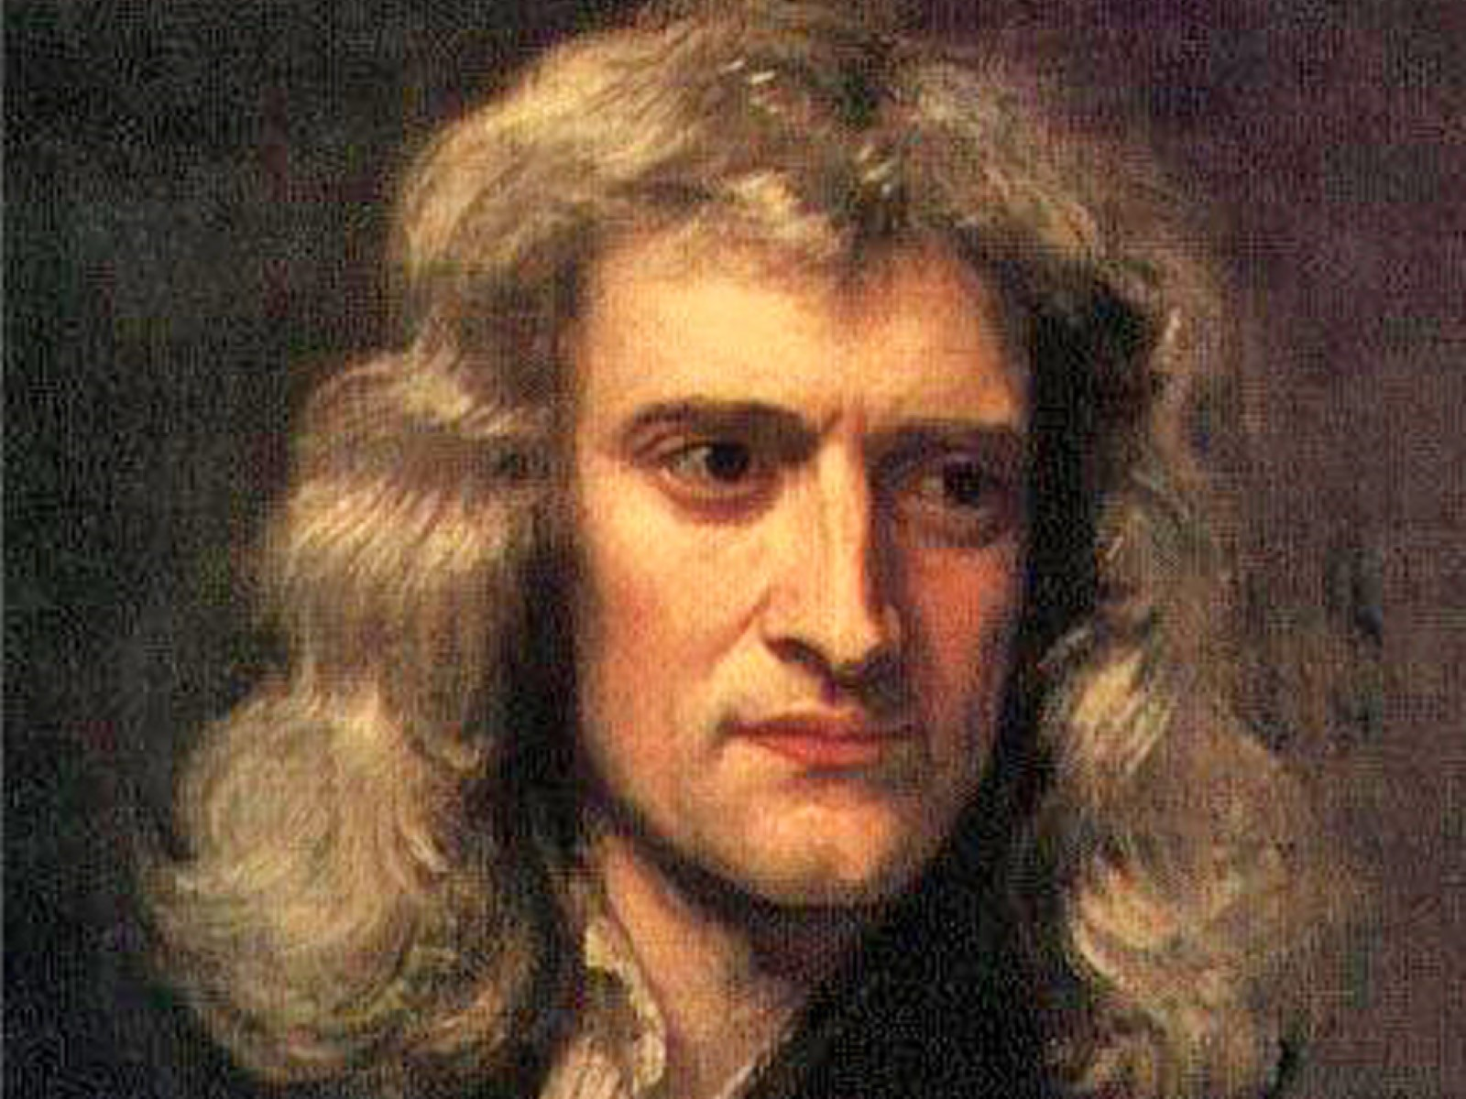

Slide 89
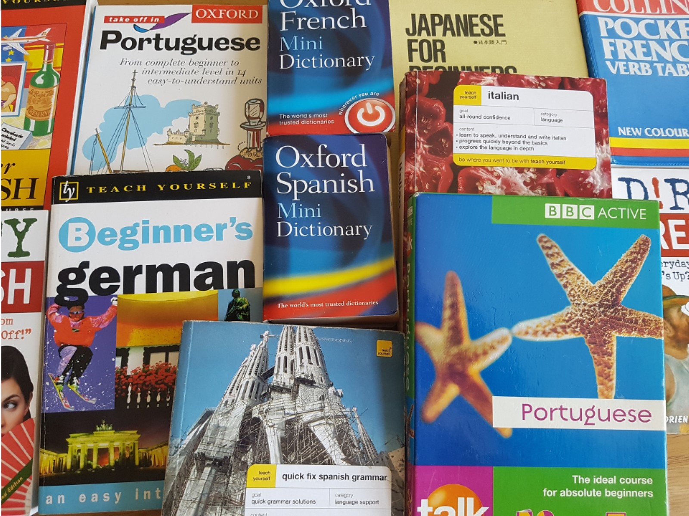

Slide 90
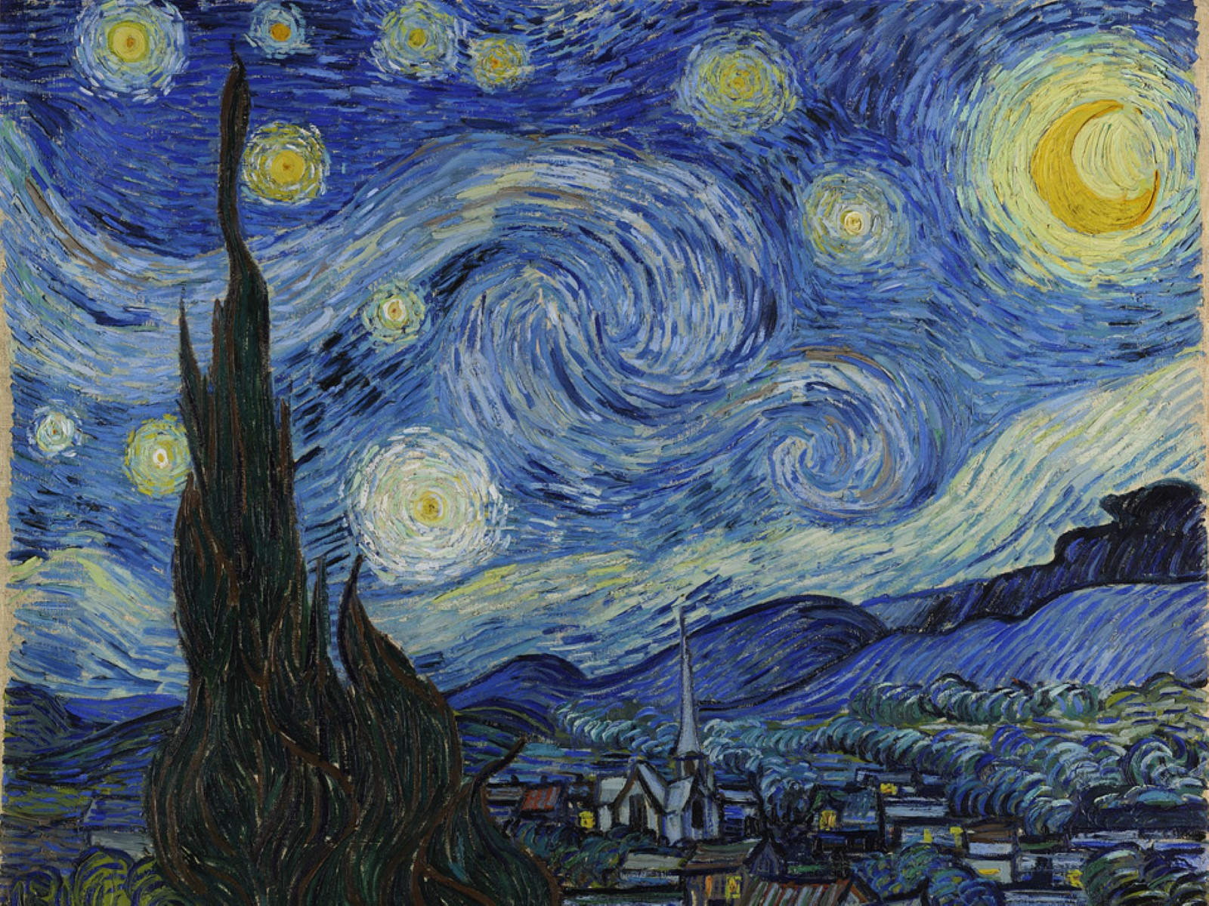

Slide 91
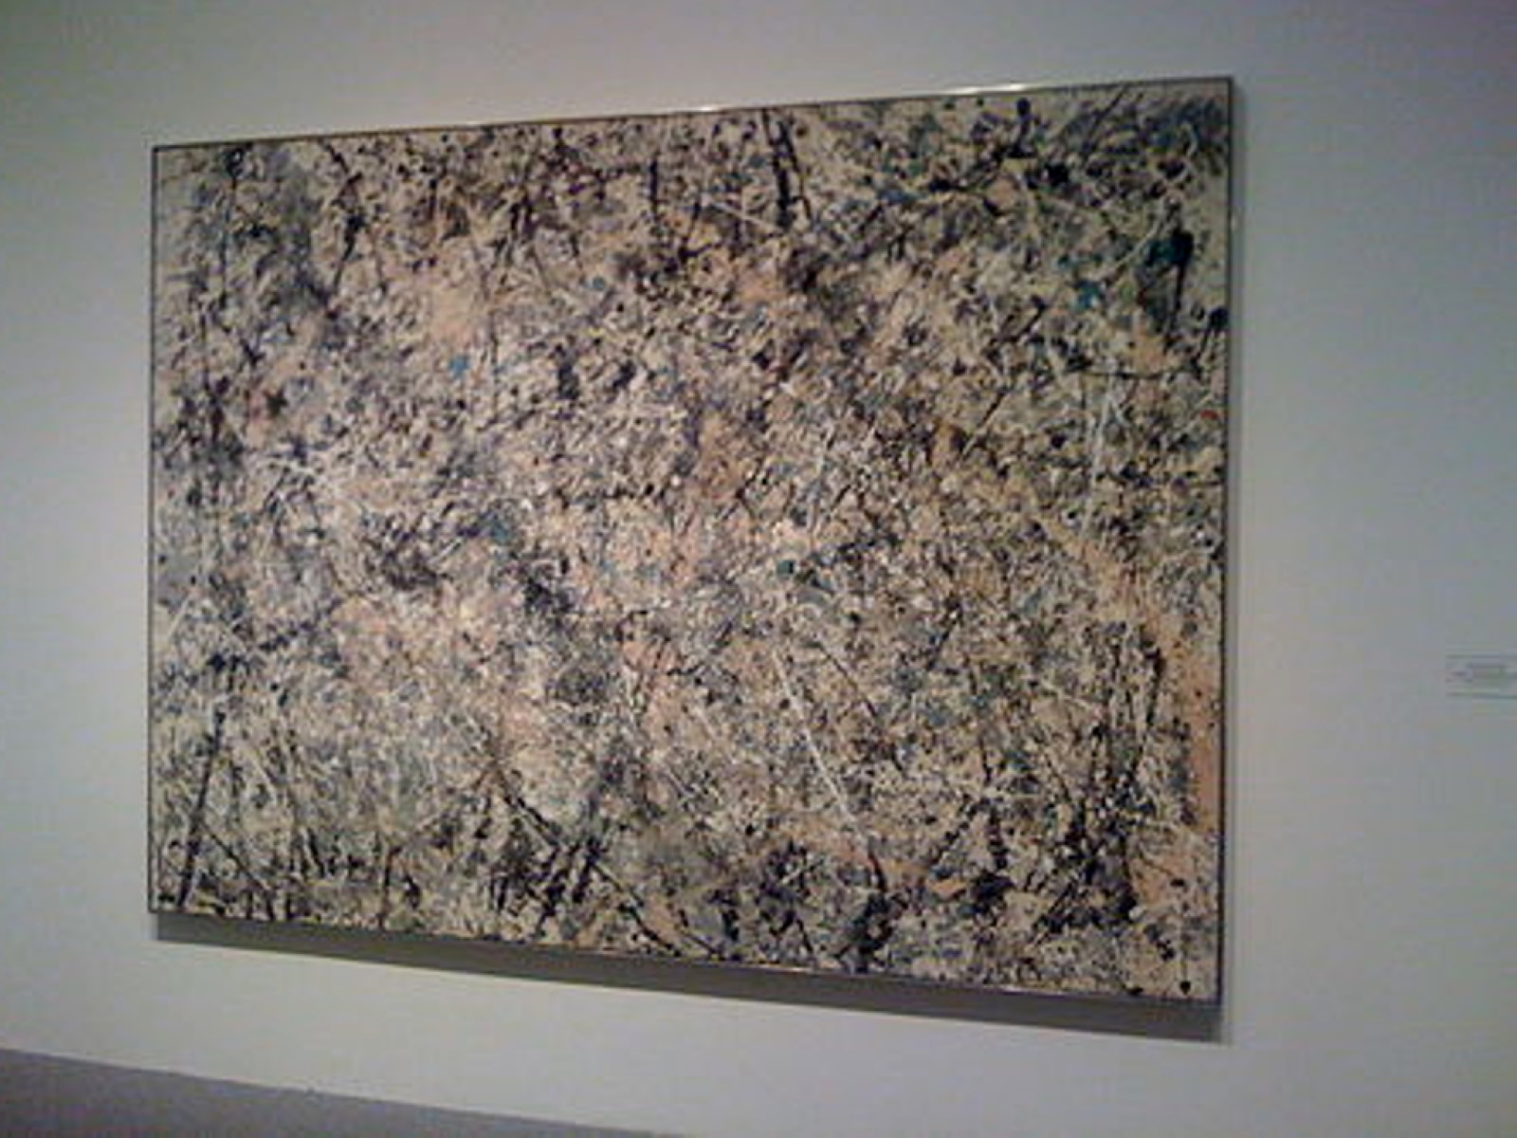

Slide 92
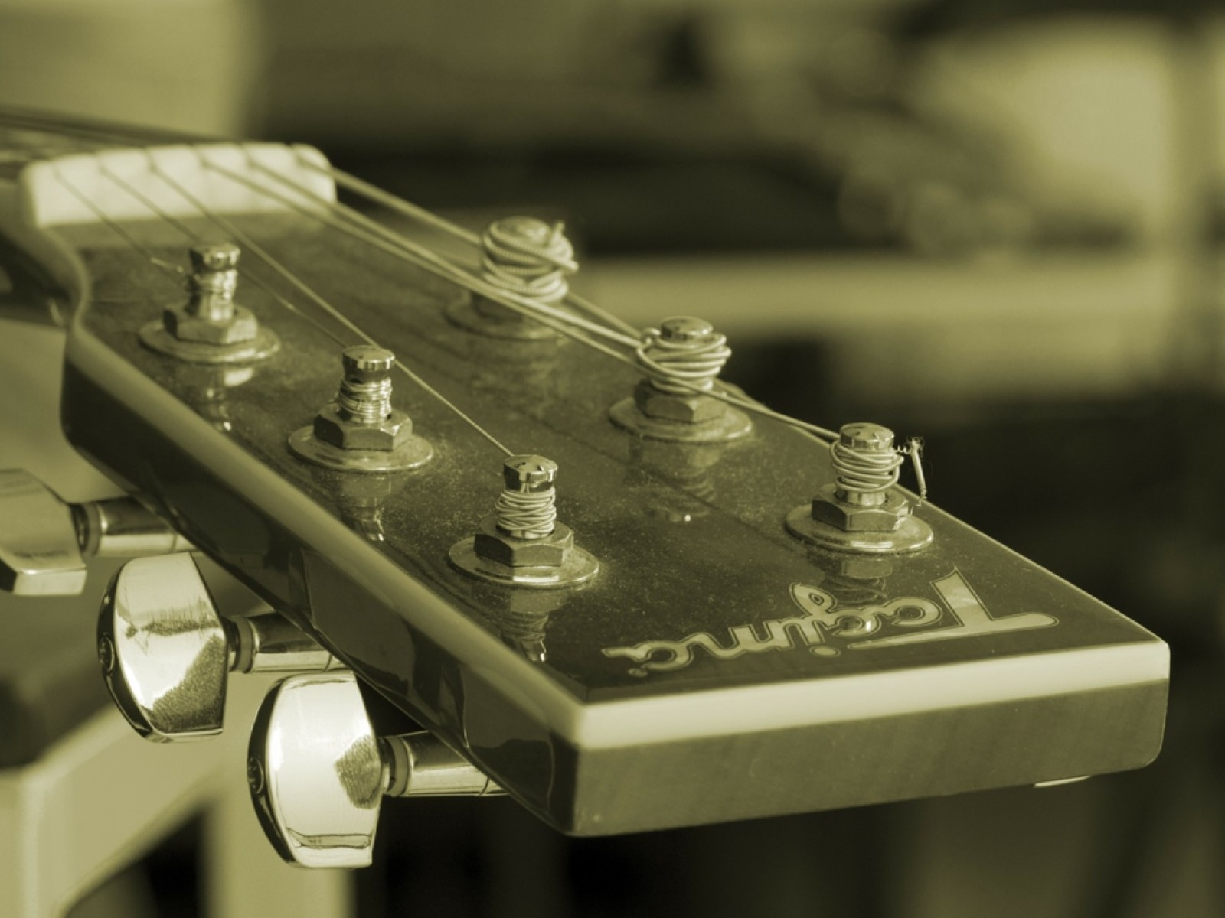

Slide 94
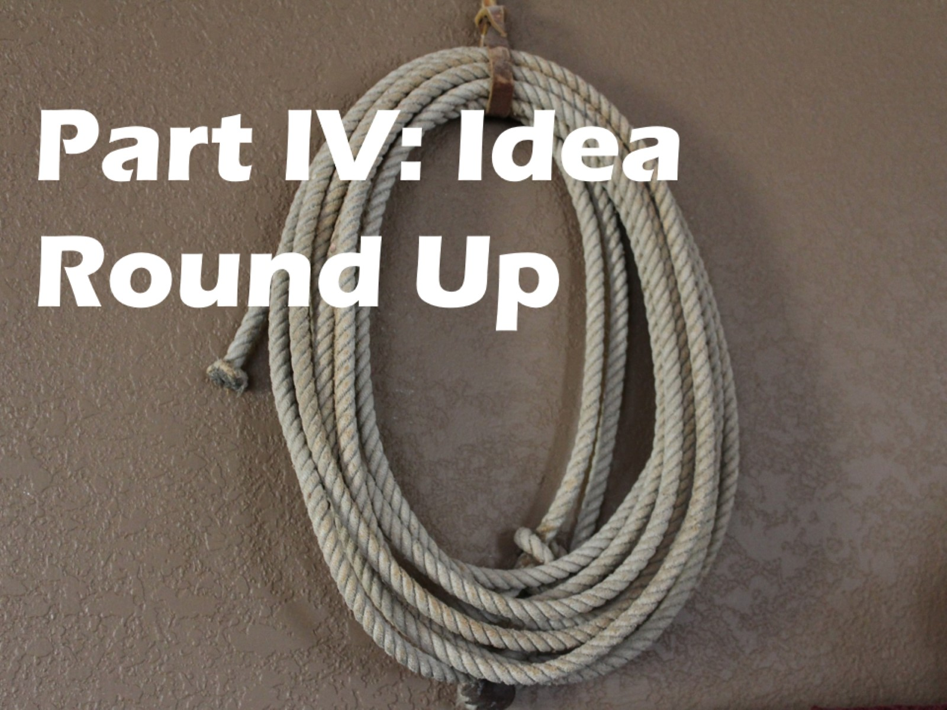
Part IV: Idea Round Up

Slide 95
Teach the Intensities

Slide 96
Connect the intensities to your content.

Slide 97
It’s that simple, pard’ner.

Slide 98
Connect with us!

