Slide 1
Grouping without Fear with Lisa Van Gemert | giftedguru.com

Slide 2
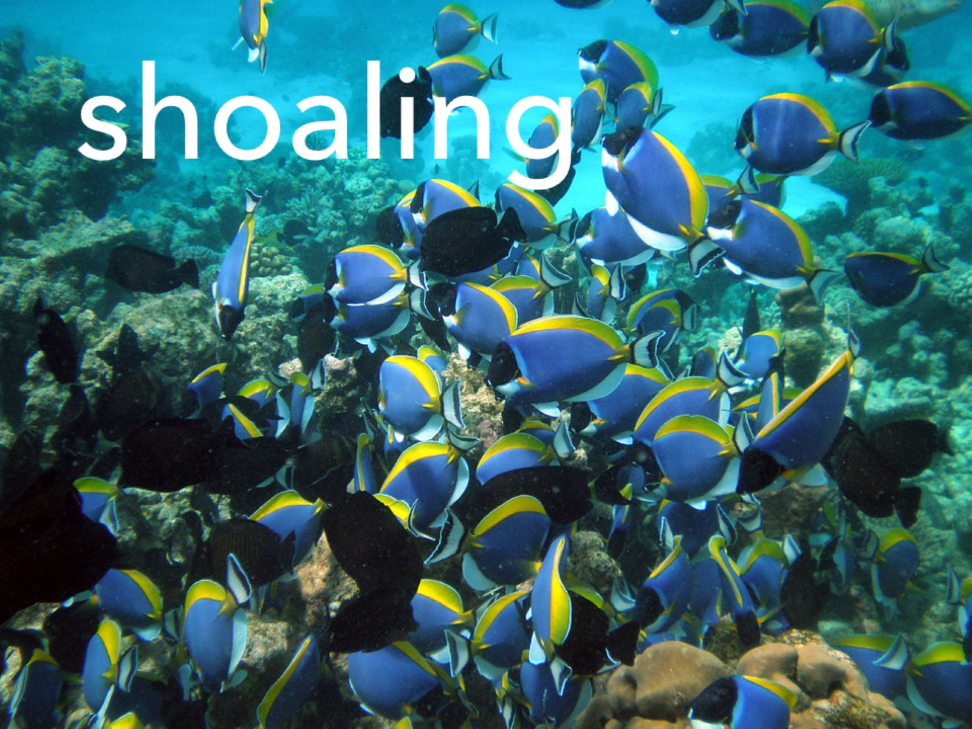

Slide 3
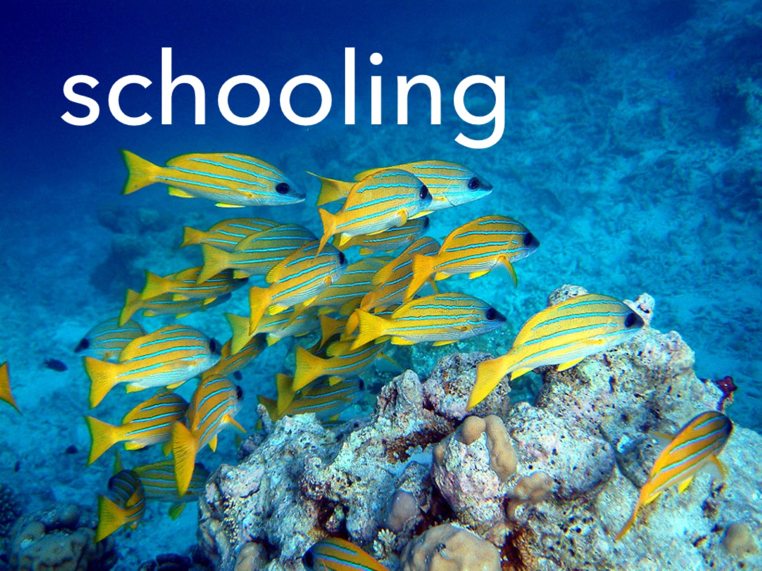

Slide 4
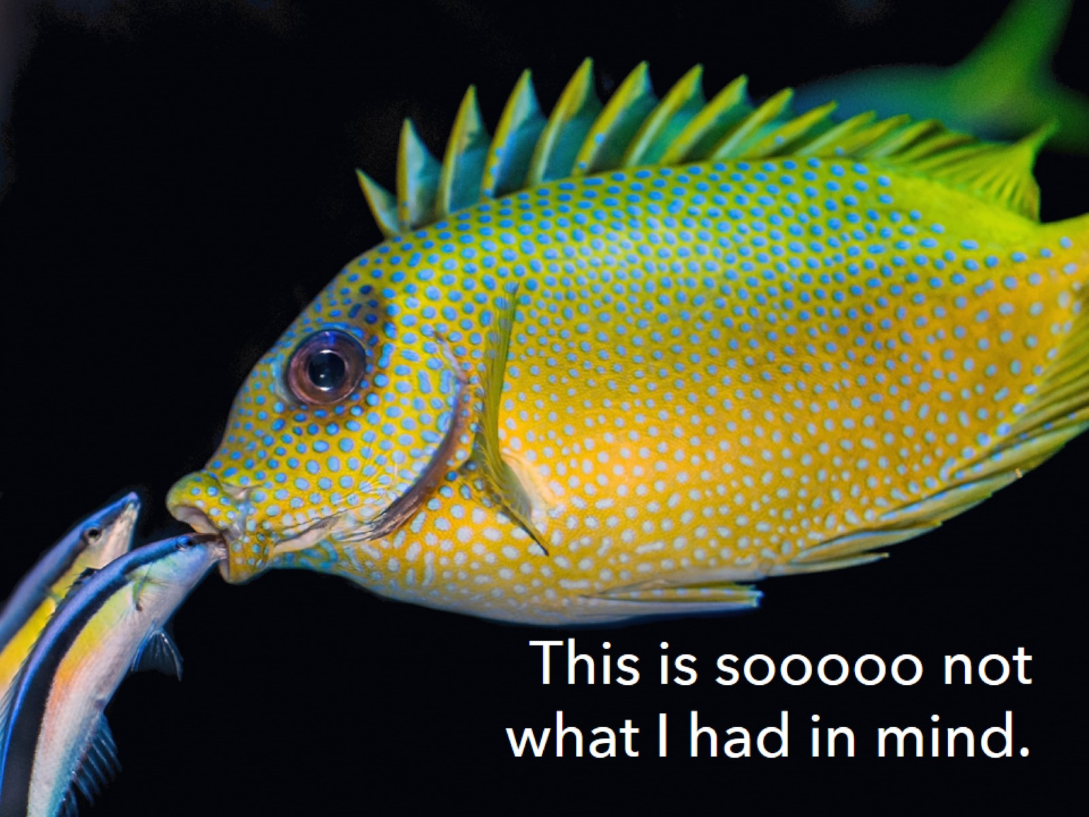
This is sooooo not what I had in mind.

Slide 5
Let’s be groupers!

Slide 6
Lead by example.

Slide 7
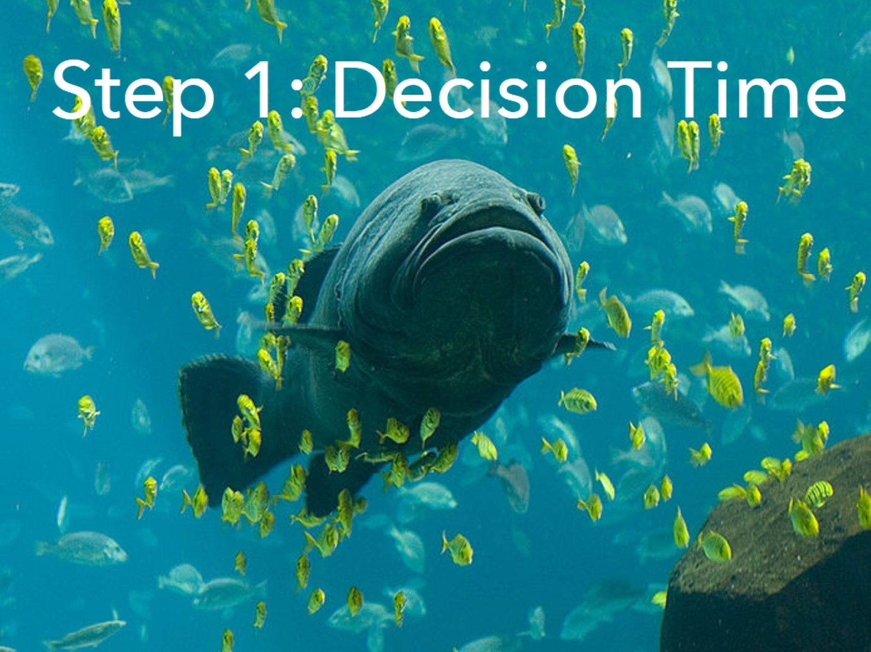
Step 1: Decision Time

Slide 8
Keep in Mind: Whole group is okay

Slide 9
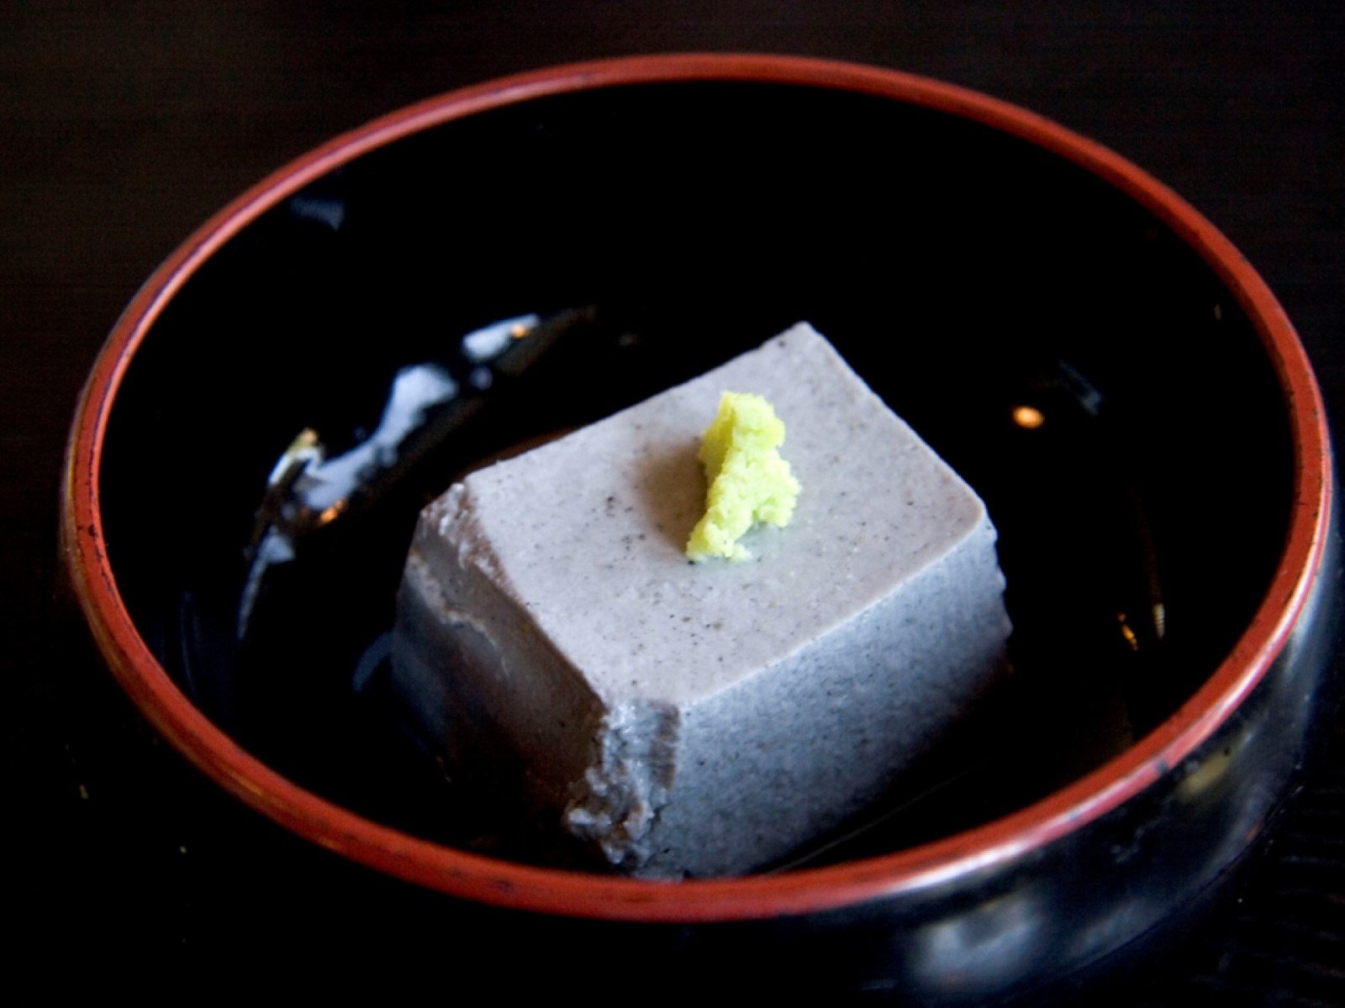

Slide 11
Can students benefit from a different perspective on this?

Slide 12
Is this material new to everyone?

Slide 13
Is there a tutor chance here?

Slide 14
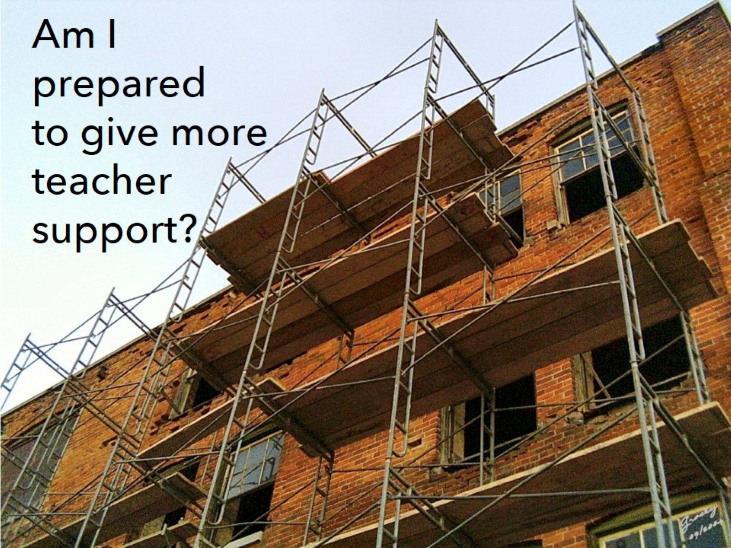
Am I prepared to give more teacher support?

Slide 15
If it’s a virtual experience, will grouping add or subtract from the collaboration?

Slide 16
Could it build relationships?

Slide 17
If collaborative grouping is right, then which kind?

Slide 18
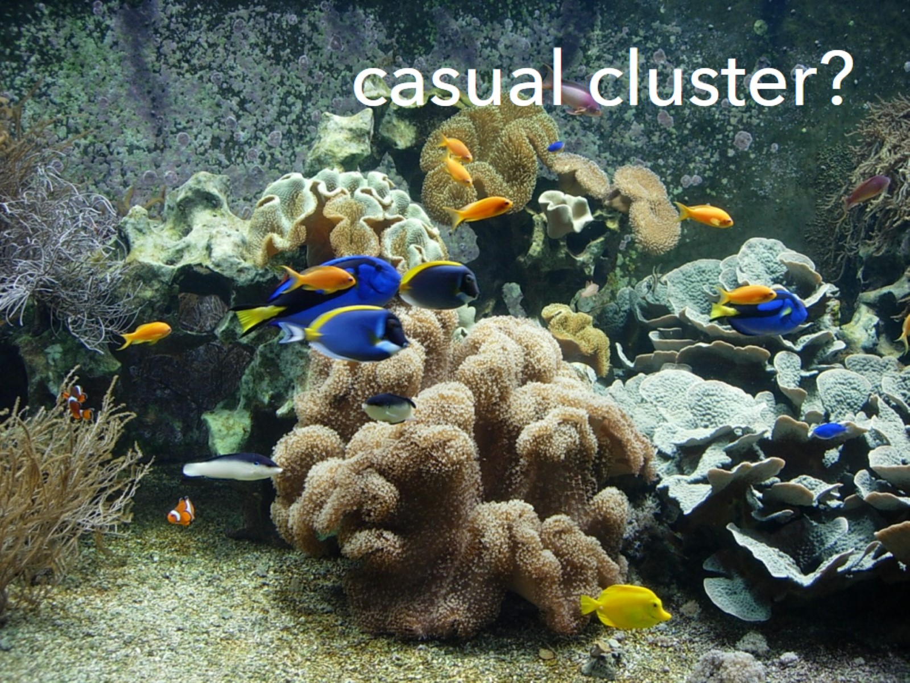
casual cluster?

Slide 19
Will hybrid grouping work here? {jigsaw with an expert}

Slide 20
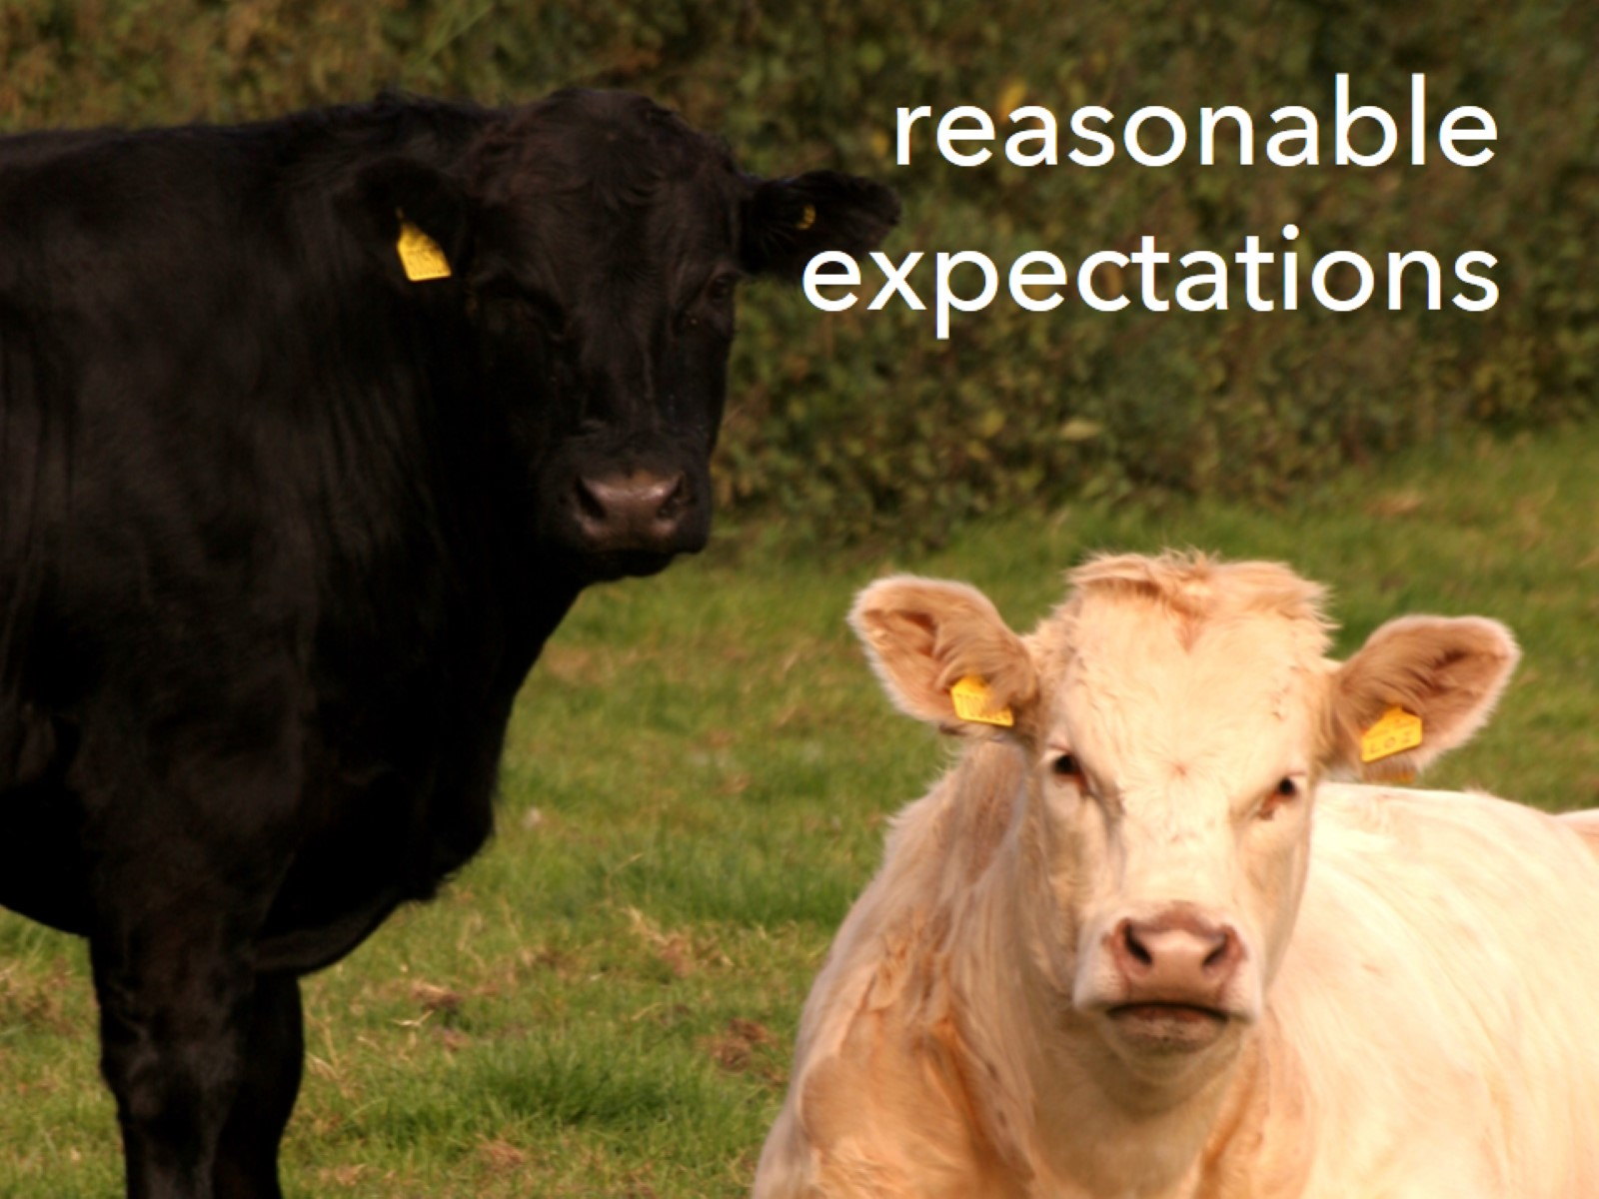
reasonable expectations

Slide 21
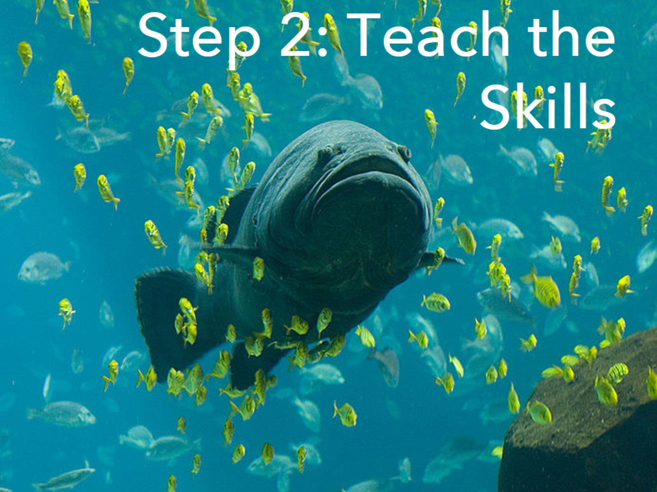
Step 2: Teach the Skills

Slide 22
Listen well.

Slide 23
clear and concise speech

Slide 24
Use graphic organizers to teach this.

Slide 25
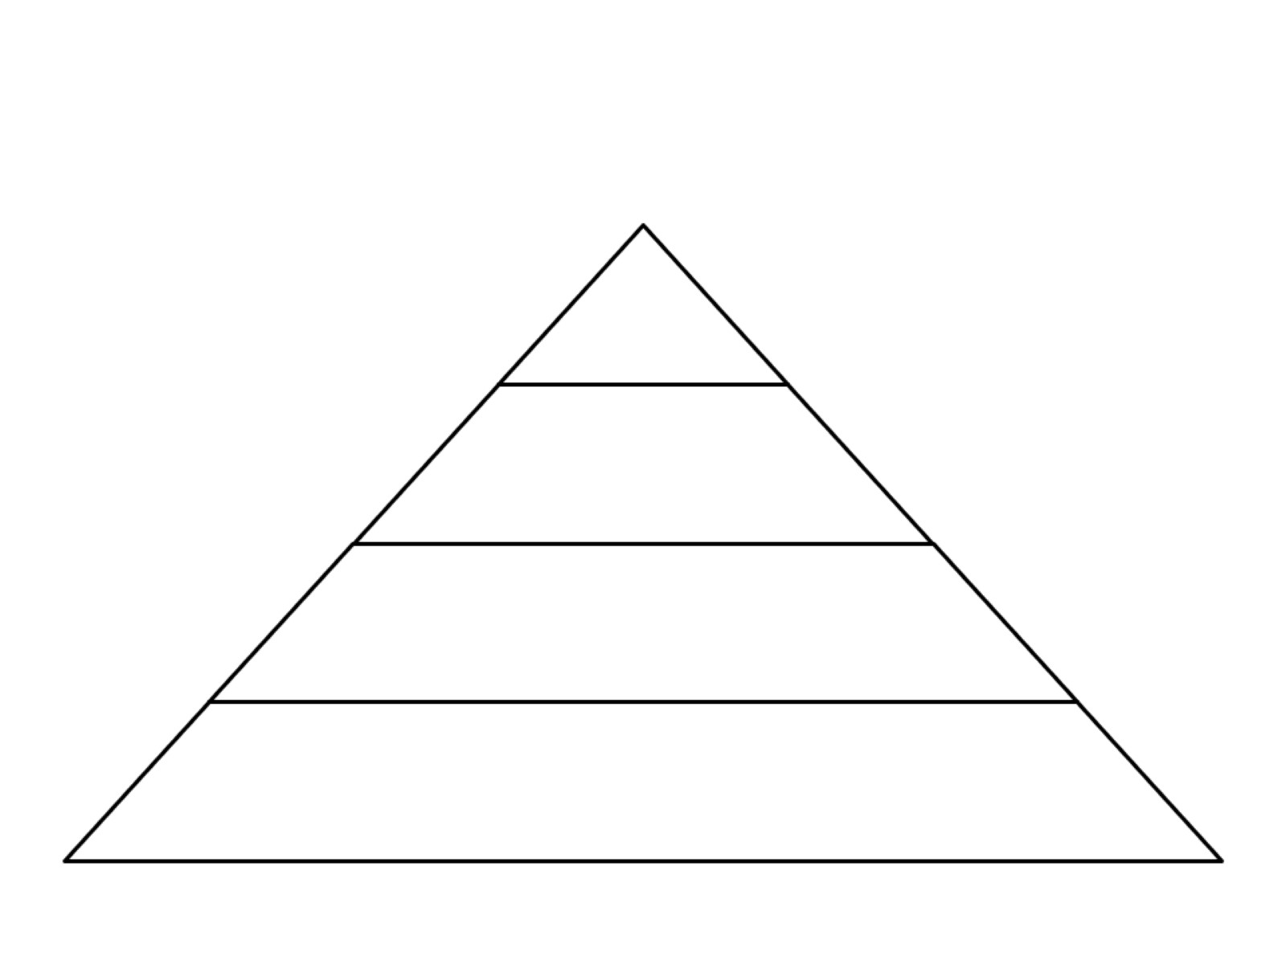

Slide 26
Come to consensus.

Slide 27
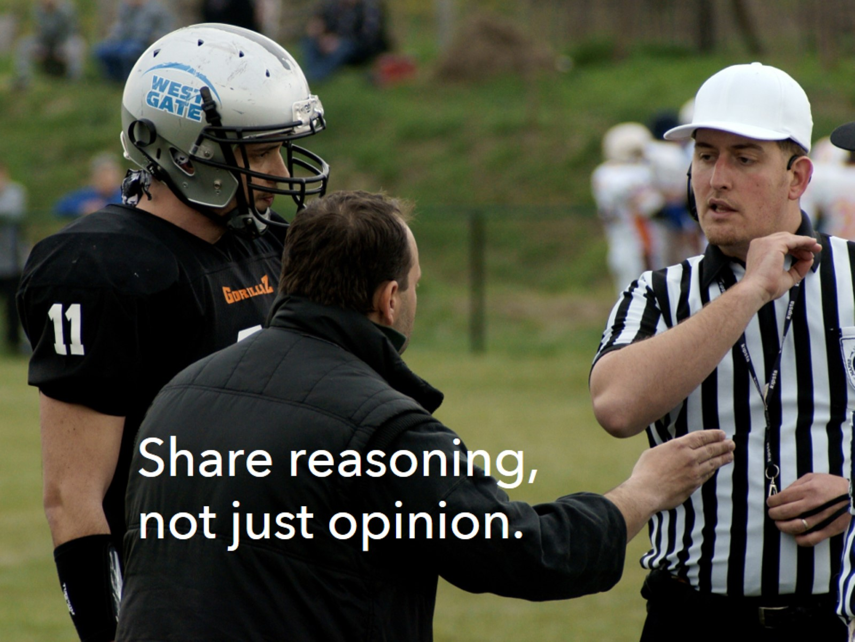
Share reasoning, not just opinion.

Slide 28
take turns

Slide 29
Give time for self-reflection.

Slide 31
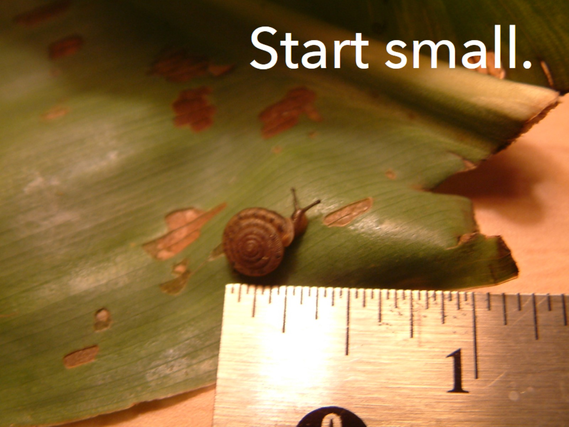
Start small.

Slide 32
Mind your manners.

Slide 33
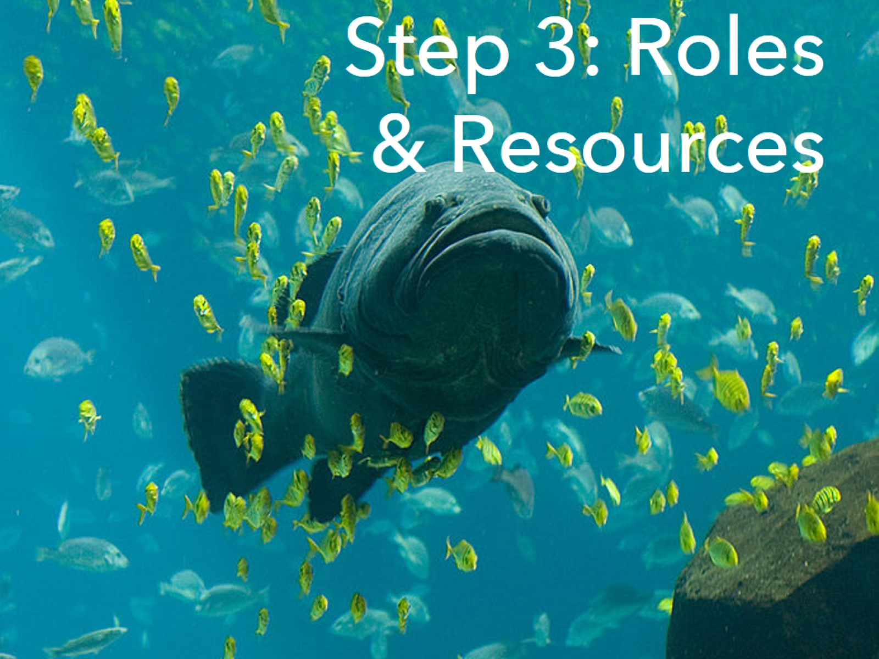
Step 3: Roles & Resources

Slide 34
Divide deliberately.

Slide 35
Create team identity.

Slide 36
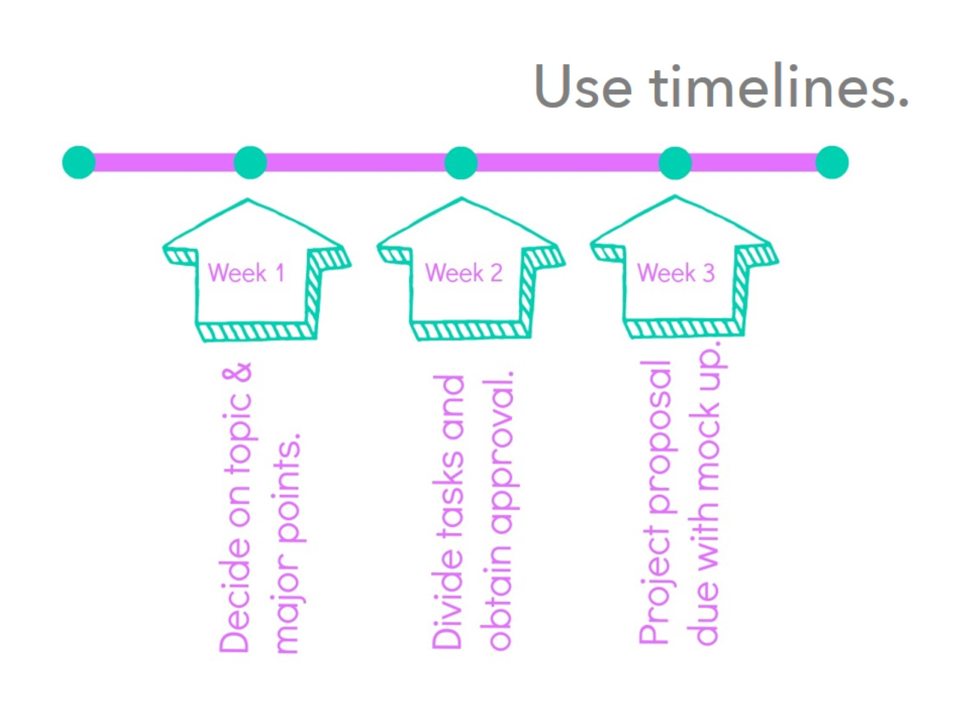
Use timelines.

Slide 38
Who does what? Who has what?

Slide 39
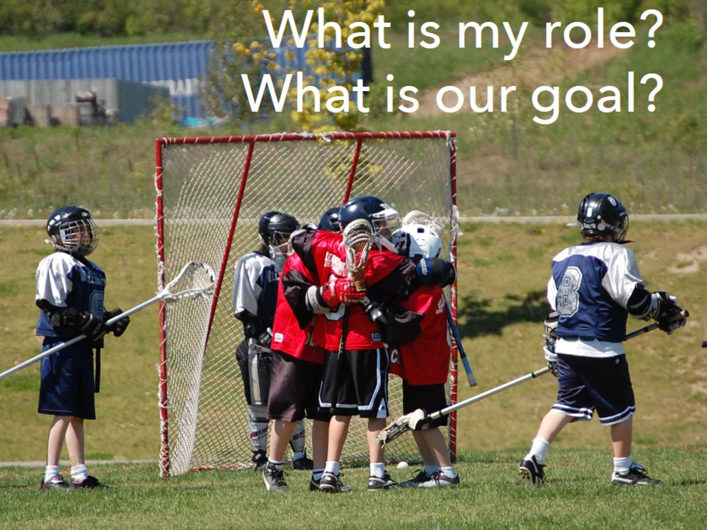
What is my role? What is our goal?

Slide 40
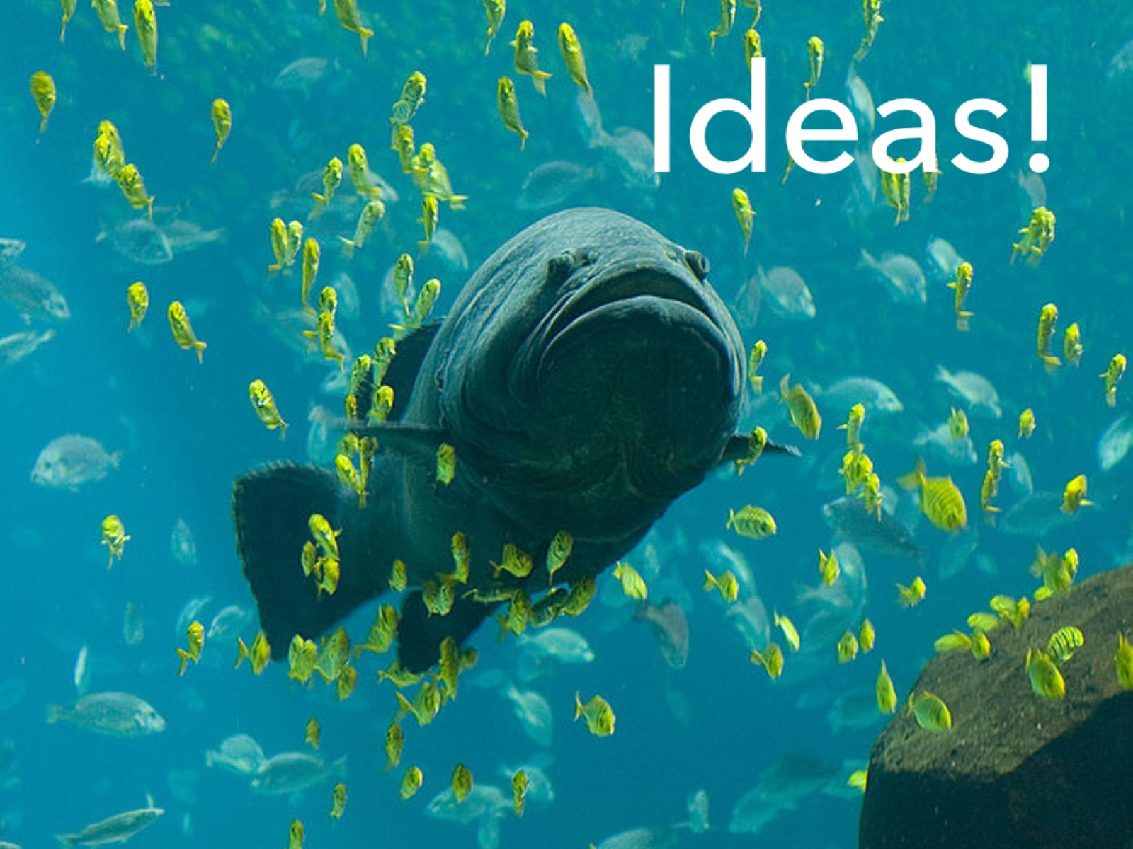
Ideas!

Slide 41
You can build it.

Slide 42
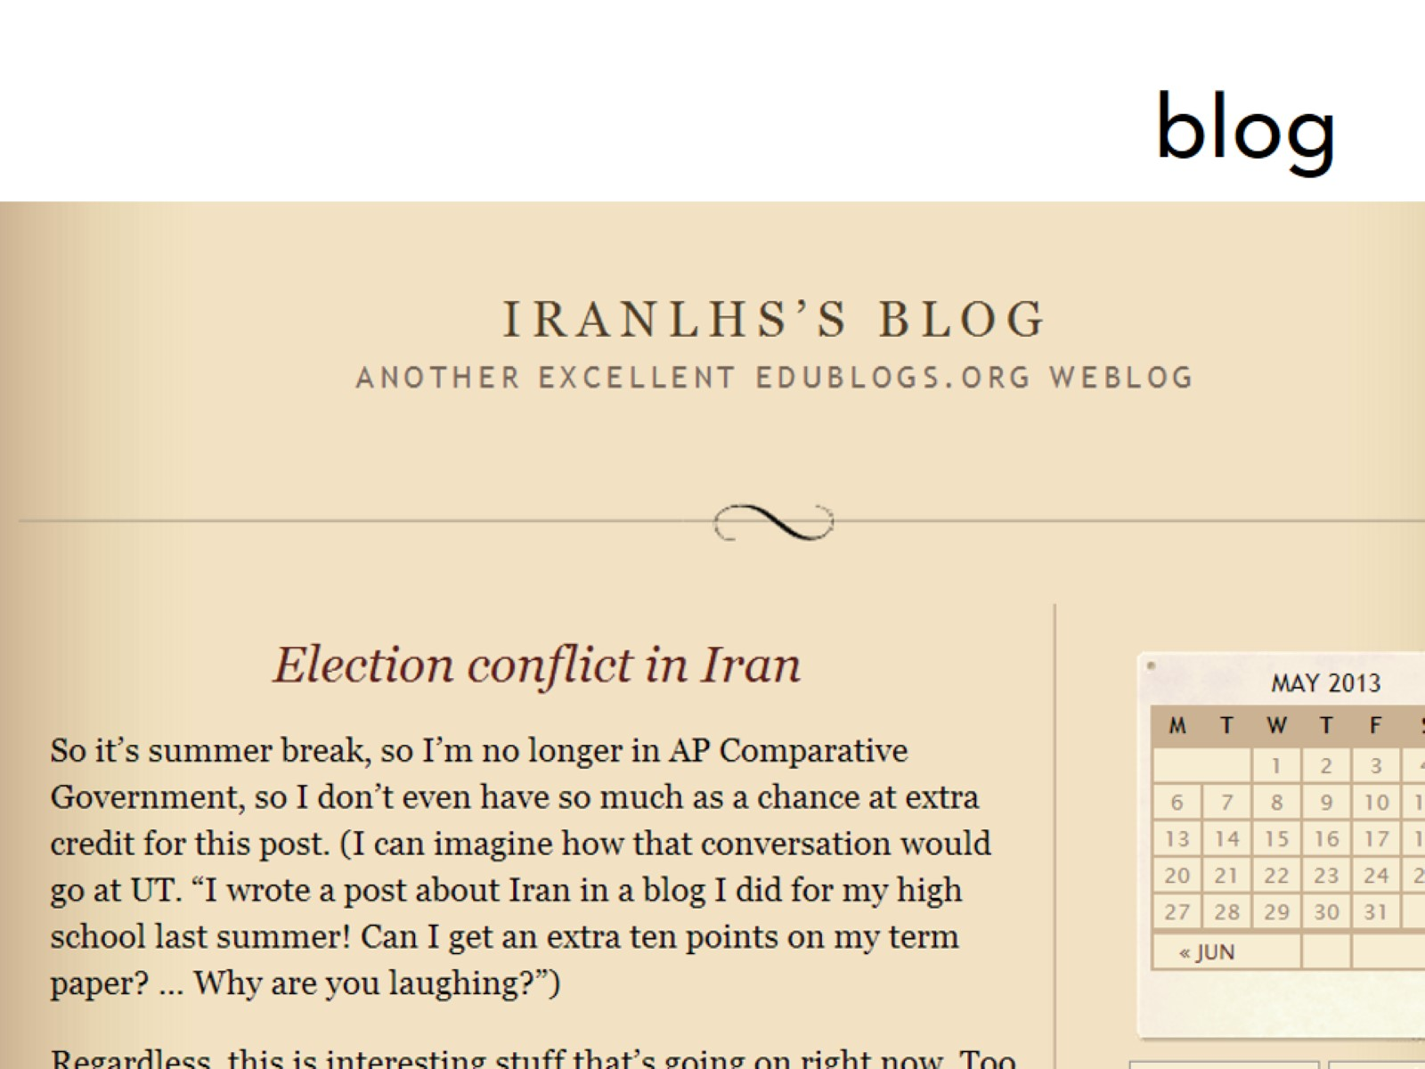
blog

Slide 43
The Googlesphere

Slide 44
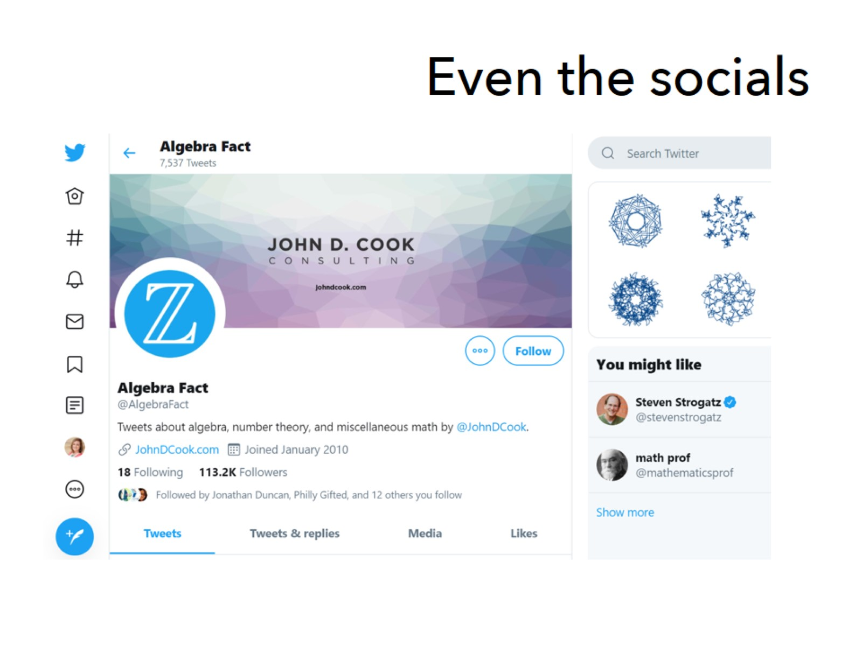
Even the socials

Slide 45
testing

Slide 46
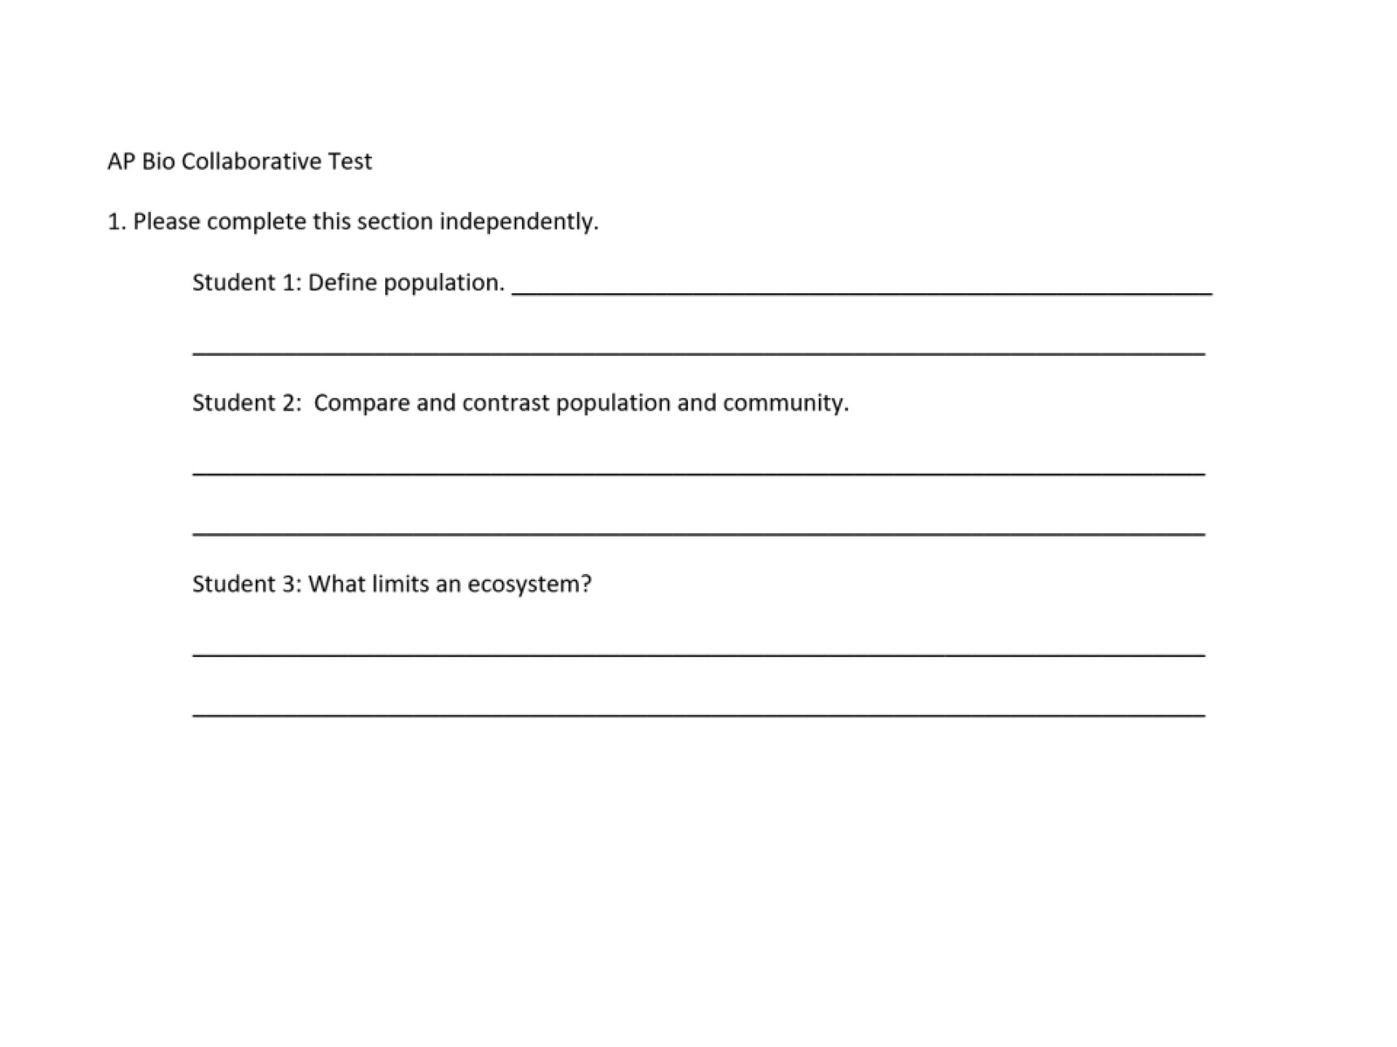

Slide 47
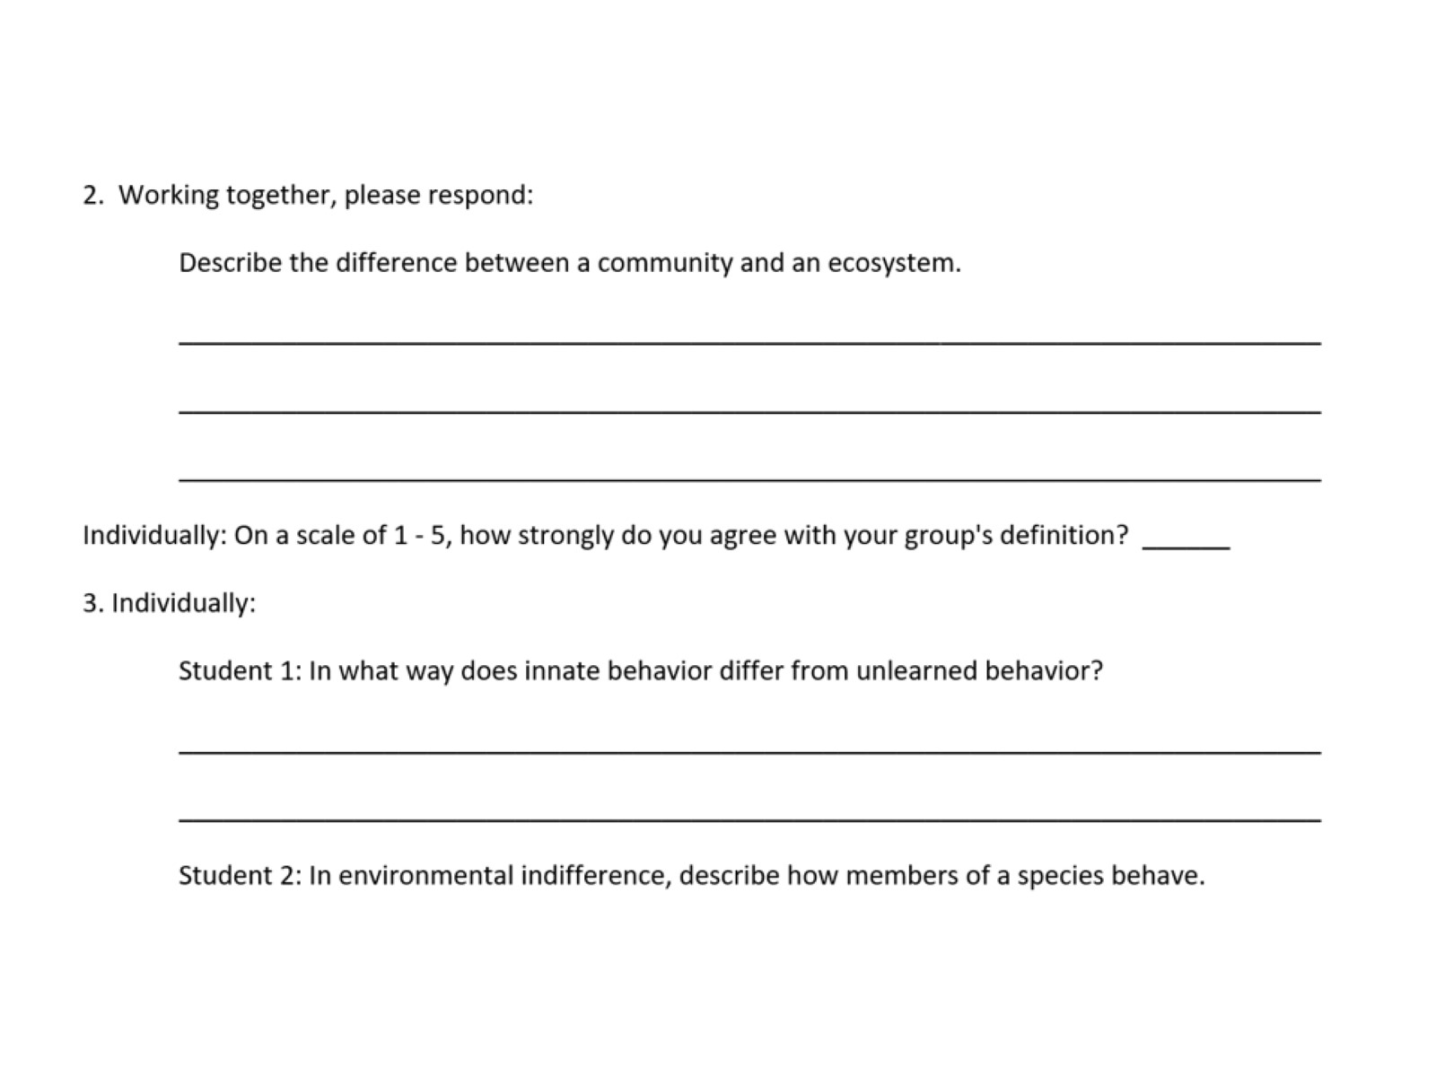

Slide 49
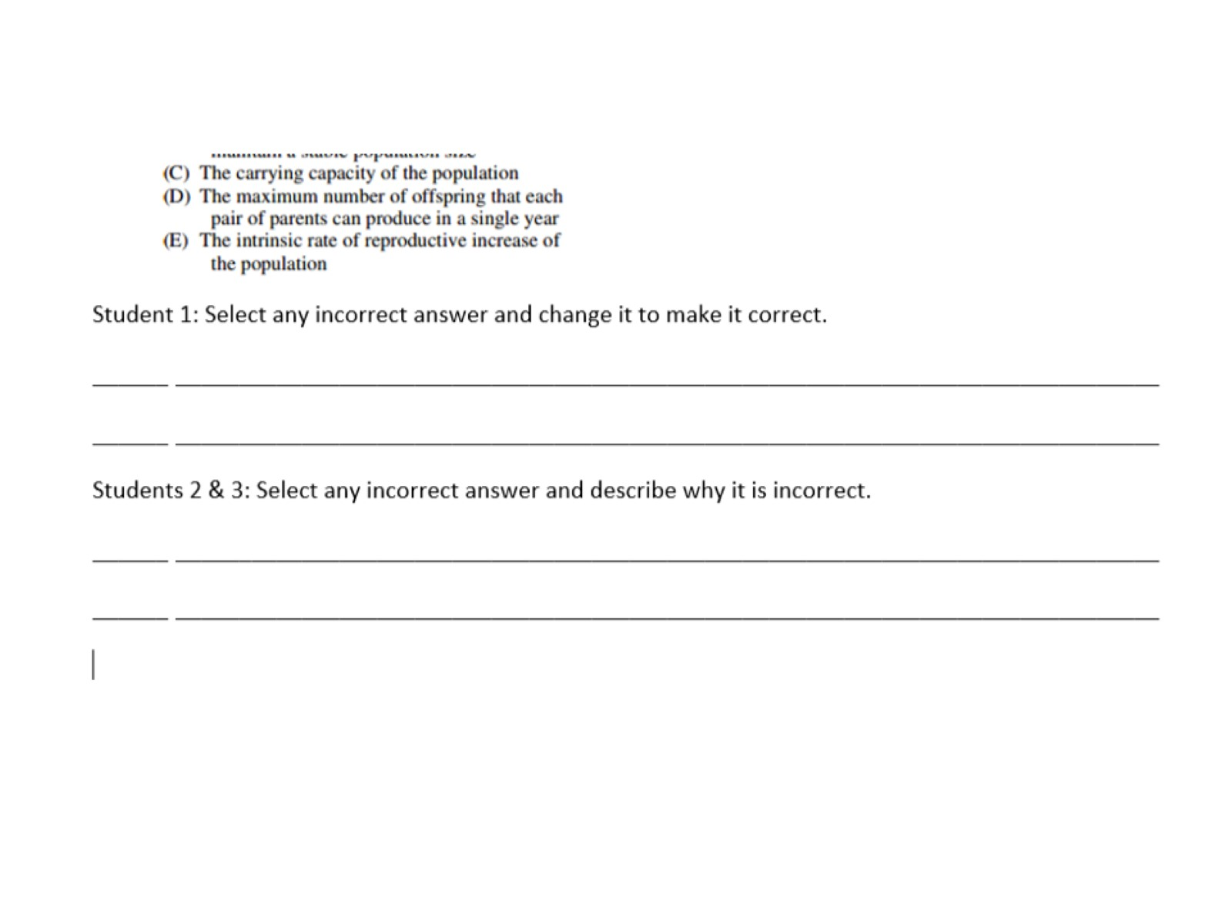

Slide 50
Fun First

Slide 51
rubrics

Slide 52
Credit Love

